Slide 1
Supporting presentation for lecturers of Architecture/Civil Engineering
Chapter 05:
Corrosion Resistance of Stainless Steels

Slide 2
Contents
Most materials decay over time
Why does stainless steel resist corrosion
Types of corrosion of stainless steels
How to select the right stainless steel for adequate corrosion resistance
  Structural applications
  Other applications
References

Slide 3
1. Most materials decay over time

Slide 4
Most materials decay over time
Material | Wood | Steel | Concrete
Type of decay | Fungi Insects Sun+rain | Rust | Cracking/ Spalling
Mitigating actions | Chemicals Paint/varnish | Galvanising Painting | Corrosion resistant rebar

Slide 5
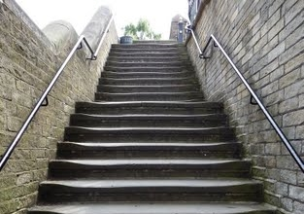

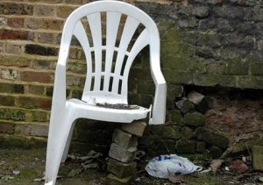
Most materials decay over time
Material | Stone | Glass | Polymers
Type of decay | Wear Damage by Pollution | Breaks | Become brittle under UV light
Mitigating actions | Usually none taken | Tempered glass | Improved polymer grades

Slide 6
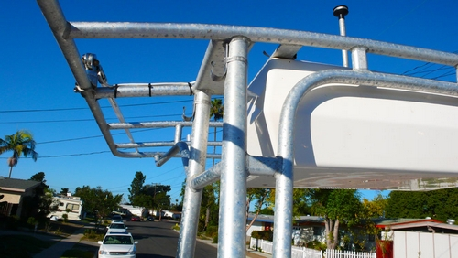
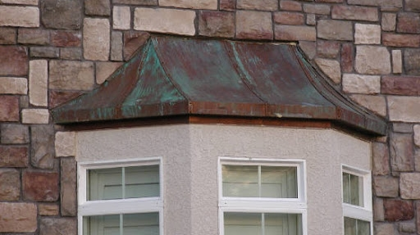
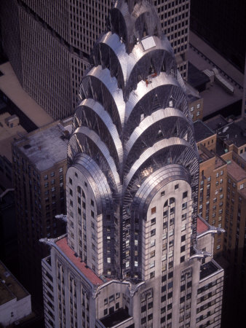
Most materials decay over time
Material | Aluminum* | Copper | Stainless
Type of decay | Pitting over time, possible galvanic corrosion | Forms a green patina over time | No decay
Mitigating actions | Galvanic corrosion can be prevented | None | None required
* Aluminum forms a thin protective oxide just like stainless, but with a much lower corrosion resistance

Slide 7
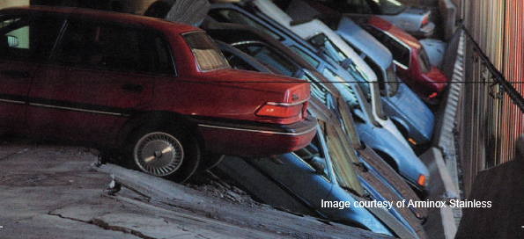
Corrosion in concrete
(corrosion problems are not limited to outside surfaces !)
Corrosion of unprotected carbon steel occurs even inside reinforced concrete structures as chlorides present in the environment (marine/deicing) diffuse through the concrete.
Corrosion products (rust) have a higher volume than the metal, create internal tensions causing the concrete cover to spall.
Mitigating the corrosion of steel reinforcing bar in concrete is a must.
Various techniques are used: thicker concrete cover; cathodic protection; membranes, epoxy coating … and stainless steel rather than C-Steel.
Stainless steel provides both strength and corrosion resistance inside the concrete, providing a long, maintenance-free service life of the structure.

Slide 8
2. Why does stainless steel resist corrosion

Slide 9
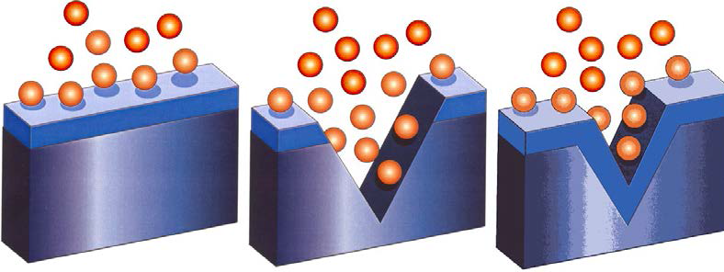
Passive Layer vs. Coatings
PASSIVE FILM on STAINLESS STEEL:
Oxy-hydroxides of Fe and Cr
Oxygen
2-3 nm thick
(0,002-0,003 µm)
Transparent
Adherent
Self repairing
Topcoat
MULTI-LAYER COATINGS
Typically
Coat
20-200 µm thick
May peel off
Not self-repairing
Primer
MILD STEEL

Slide 10
Damage to protective layer
Stainless Steel
Mild Steel
Passive film
Multi-layer Coating
Self Repair
Corrosion Products

Slide 11
3. Types of corrosion of stainless steels

Slide 12

Effect of Chromium Content on Atmospheric Corrosion Resistance (uniform corrosion)
Corrosion Rate
mmpy
0.200
Plain Carbon Steel
0.175
0.150
0.125
0.100
0.075
Stainless Steels
> 10.5 Cr %
0.050
0.025
0
2
4
6
8
10
12
14
16
% Chromium

Slide 13
When the selection of the stainless steel grade has not been properly made, corrosion may occur
…no material is perfect!
think of it as selecting the right vehicle
for the intended use

Slide 14
Types of corrosion on stainless steels
Uniform
Pitting
Crevice
Galvanic
Intergranular
Stress corrosion cracking
See Reference 1

Slide 15
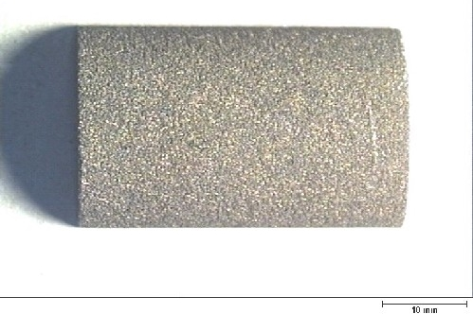
a) What is uniform corrosion?
When the passive film is destroyed by the aggressive environment, the whole surface corrodes uniformly and metal loss can be expressed as µm/year
This is typical of unprotected Carbon steels.
This does not occur on stainless steels in the building industry, as the corrosion conditions are never that aggressive (it requires typically immersion in acids)

Slide 16
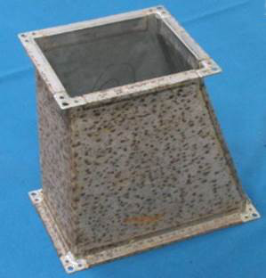
b) What is pitting corrosion^{1,2,3,7}?
Pitting corrosion, or pitting, is a form of extremely localized corrosion that leads to the creation of small holes in the metal.
This picture shows pitting of stainless steel EN1.4310
(AISI 301) resulting from insufficient corrosion resistance in a very aggressive chlorinated environment.

Slide 17
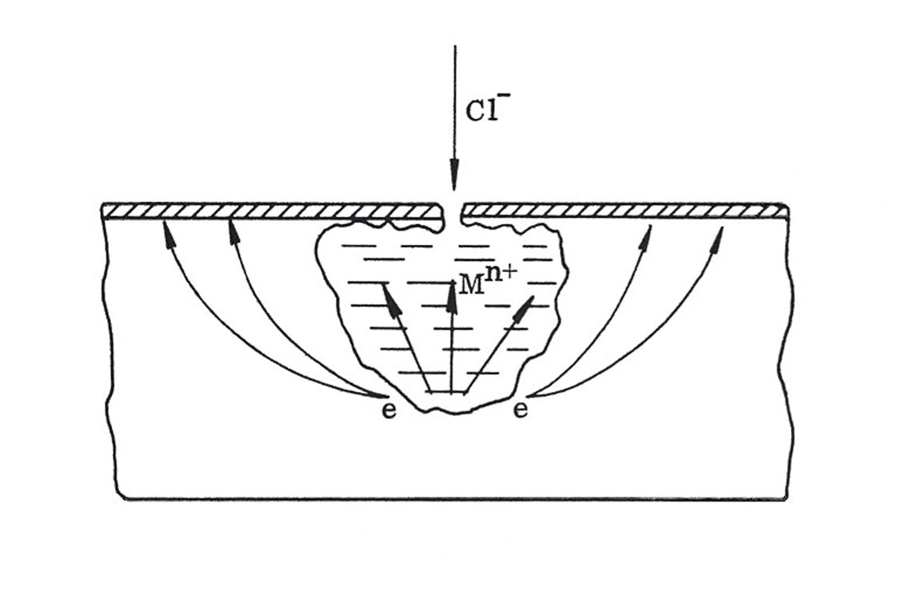
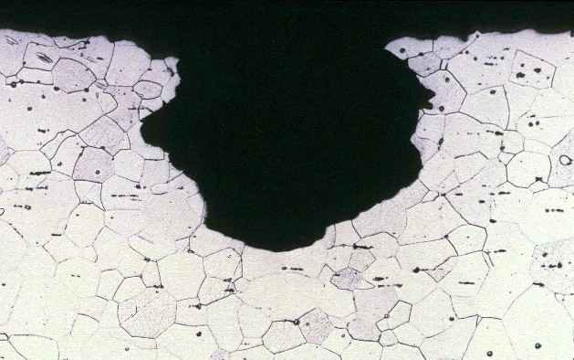
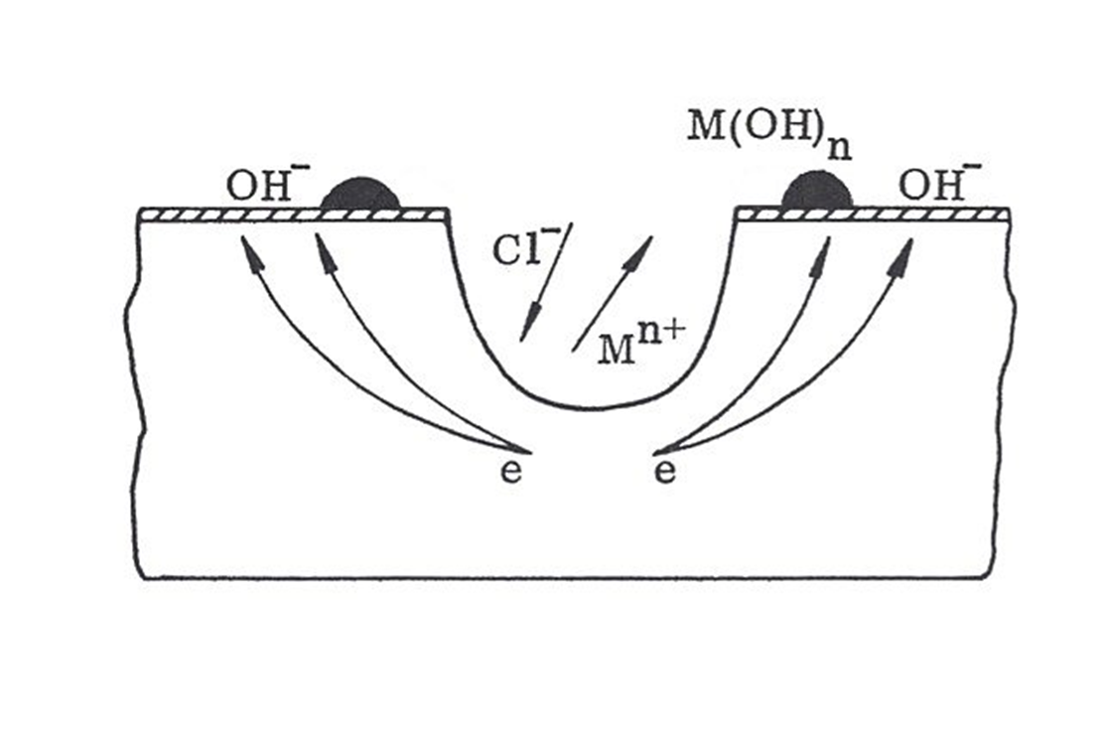
Pitting corrosion mechanisms
Initiation on a very small surface irregularities or non-metallic inclusions
Propagation as the electrochemical reactions in the pit cavity are not prevented by re-passivation

Slide 18
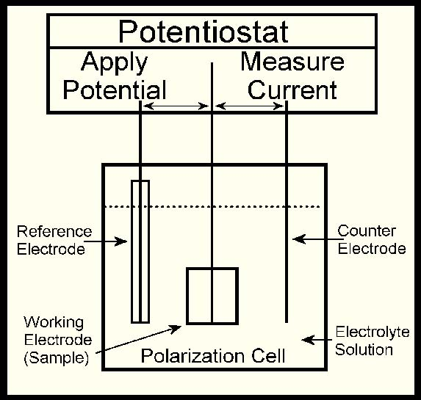
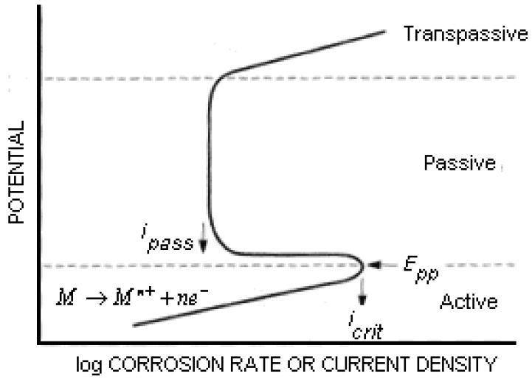
Pitting can be reproduced in an electrochemical cell⁴
Corrosion involves the dissolution of metal, i.e. an electrochemical process with
  electrochemical reactions at the surface of the metal and
  a current between the corroding metal (anode) and a cathodic part
These processes can be simulated in an electrochemical cell, a device that allows the study of corrosion processes
Electrochemical cell
E_{pit}
Polarization curve

Slide 19
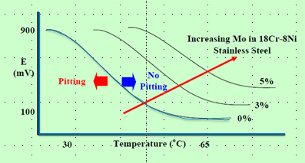
Major factors that influence pitting corrosion¹
(the pitting potential E_{pit} is generally used as the criterion for pitting)
Temperature
Increasing the temperature reduces drastically the resistance to pitting.

Slide 20

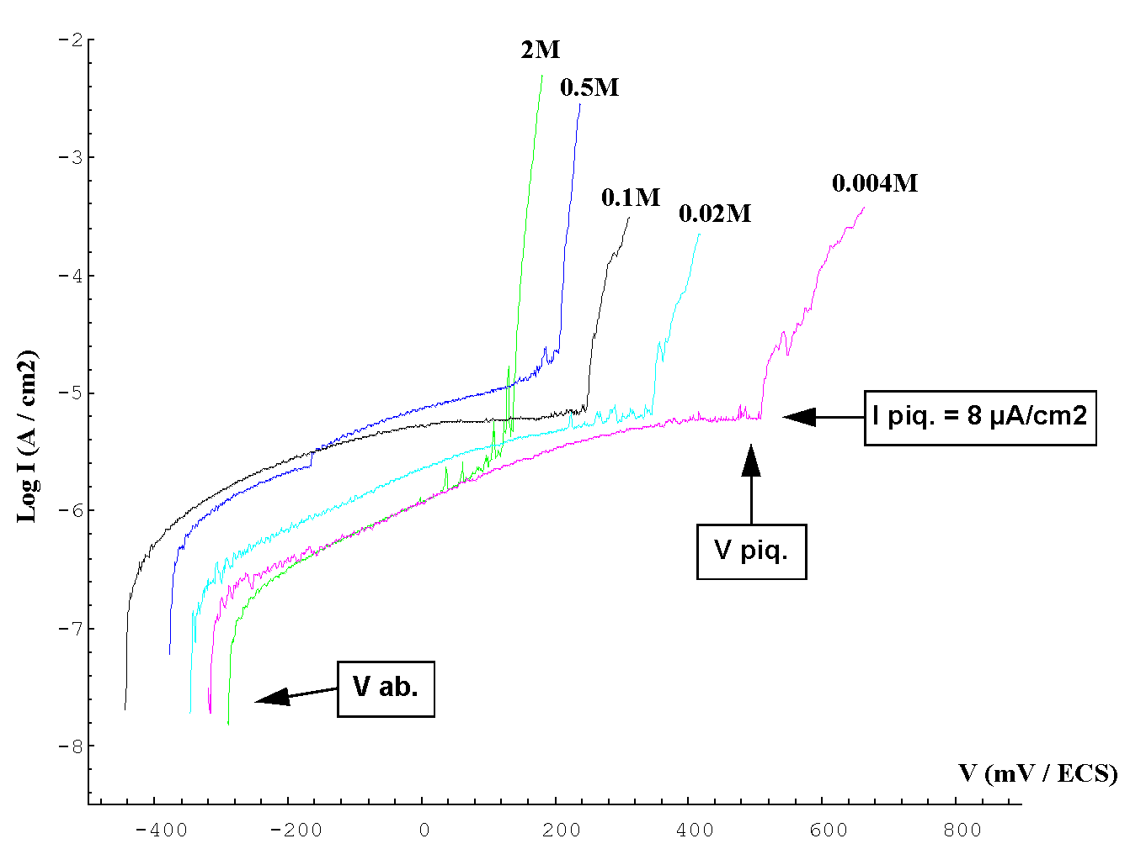
Major factors that influence pitting corrosion⁵
(the pitting potential E_{pit} is generally used as the criterion for pitting)
2. Chloride concentration
The pitting resistance decreases a the Cl⁻ concentration increases (the log of the Cl⁻ concentration)
Notes:
http://corrosion.kaist.ac.kr/download/2008-1/chap11.pdf
Ugitech: private communication

Slide 21
Major factors that influence pitting corrosion¹
(the pitting potential E_{pit} is generally used as the criterion for pitting)
3. Stainless steel analysis
The pitting resistance increases strongly with some alloying elements: N, Mo, Cr
The role of the alloying elements is described by the PREN (Pitting Resistance Equivalent Number)

Slide 22
Pitting Resistance Equivalent Number (PREN)⁶
Updated!
By calculating the PREN it is possible to compare stainless steel grades resistance against pitting. The higher the number the better the resistance.
Obviously the PREN alone cannot be used to predict whether a particular grade will be suitable for a given application
PREN = Cr + 3.3Mo + 16N, where
Cr = Chromium content
Mo = Molybdenum content
N = Nitrogen content
EN | AISI | PREN
1.4003 1.4016 | - 430 | 10.5 - 12.5 16.0 - 18.0
1.4301 1.4311 | 304 304LN | 17.5 - 20.8 19.4 – 23.0
1.4401/4 1.4406 | 316/L 316LN | 23.1 – 28.5 25.0 – 30.3
1.4439 1.4539 | 317L - | 31.6 – 38.5 32.2 – 39.9
1.4362 1.4462 1.4410 1.4501 | - - - - | 23.1 – 29.2 30.8 – 38.1 40 40
Please note that the PREN does not involve Ni.
The resistance to pitting corrosion does not depend upon the Ni content of the stainless steel. See next slide

Slide 23
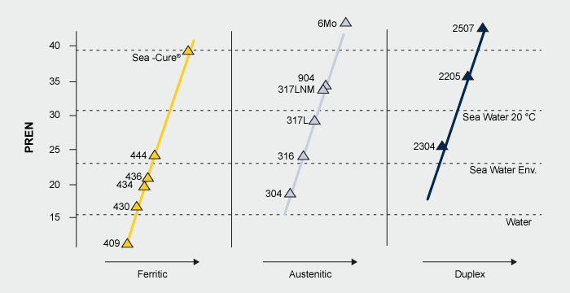
PREN of some common grades⁹
Updated!
- - - - - - - - - -
Ferritic stainless steels can match 304 and 316 austenitic stainless steels in pitting corrosion resistance.
Note: Please see Appendix for EN standards designations

Slide 24
c) What is Crevice Corrosion¹?
Crevice corrosion refers to corrosion occurring in confined spaces to which the access of the working fluid from the environment is limited. These spaces are generally called crevices. Examples of crevices are gaps and contact areas between parts, under gaskets or seals, inside cracks and seams, spaces filled with deposits and under sludge piles.

Slide 25
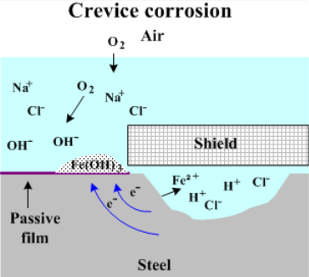
Mechanism of Crevice Corrosion
Initially, no difference between the cavity and the whole surface
Then things change when the cavity becomes depleted in oxygen
A set of electrochemical reactions occurs in the crevice, with the result of increasing Cl- concentration and decreasing the local pH, to the extent that passivation cannot occur
Then the metal in the crevice undergoes uniform corrosion

Slide 26
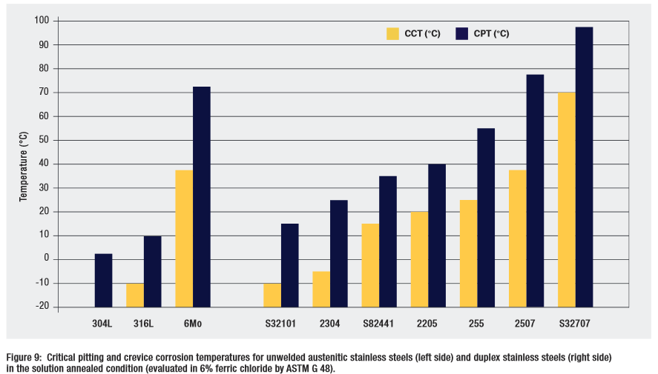
Critical Pitting Resistance Temperature (CPT)
Critical Crevice Corrosion Temperature (CCT) of various austenitic & duplex grades⁸
Note: The higher the Temperature, the better the corrosion resistance
Note: Please see Appendix for EN standards designations

Slide 27
How to avoid crevice corrosion
Optimize design:
  Use welded parts.
  Design vessels for complete drainage.
Clean to remove deposits (whenever possible)
Select a suitably corrosion resistant stainless steel (see part 4 of this chapter)

Slide 28
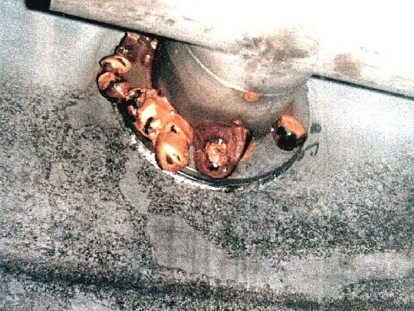
d) What is Galvanic Corrosion¹?
(also known as bimetallic corrosion)
Corrosion that can occur when 2 metals with very different galvanic potentials are in contact.
The most anodic metal is attacked
Example on the picture on the left: The stainless steel plate was secured to a stainless steel vessel, using mild steel bolts – resulting in galvanic corrosion of the bolts in presence of humidity, (=electrolyte)
See Reference 11

Slide 29
Mechanism of galvanic corrosion
Each metal has a characteristic potential when immersed in an electrolyte (measured against a reference electrode.)
When 2 metals are connected with a conducting liquid (humidity is enough):
And when the 2 metals have very different potentials
A current will flow from the most electronegative (anode) to the most electropositive (cathode).
If the anode area is small it will show dissolution of the metal
Electrolyte
Current Flow
electronegative
electropositive
Metal 1
Metal 2
Anode
Cathode

Slide 30
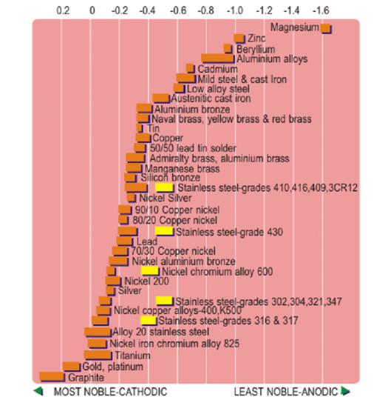
Galvanic series for metals in flowing sea water.

Slide 31
Basic rules on how to avoid galvanic corrosion
Updated!
Avoid situations of dissimilar metals
When dissimilar metals are in contact make sure that the less noble metal (anode) has a much larger surface area than the more noble metal (cathode)
Examples:
  Use Stainless steel fasteners for Aluminum products (and never Aluminum fasteners for stainless)
  Same between stainless steel and carbon steel
In concrete ( high pH) contaminated with chlorides, stainless steel rebar DOES NOT INCREASE SIGNIFICANTLY the corrosion rates of carbon steel rebar by galvanic coupling
References are given in www.stainlesssteelrebar.org

Slide 32
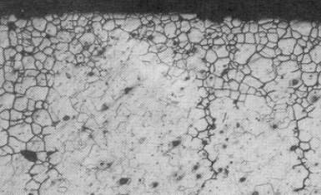
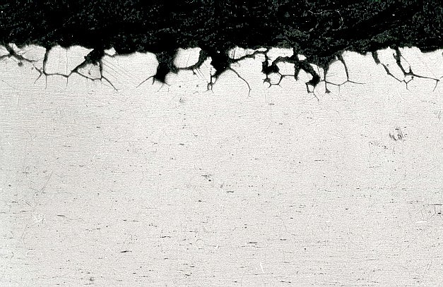
e) What is Intergranular Corrosion¹?
Intergranular attack is caused by the formation of chromium carbides (Fe,Cr)23C6 at grain boundaries, reducing the chromium content and the stability of the passive layer.
In the above micrographs, stainless steels speciments were polished then etched with a stong acid medium. The network of black lines corresponds to a strong chemical attack of the grain boundaries which exhibit a much lower corrosion resistance than the grains themselves.

Slide 33
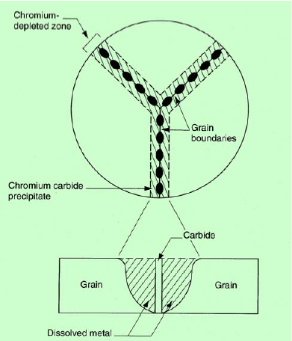

Schematic view of Cr depletion at grain boundaries

Slide 34
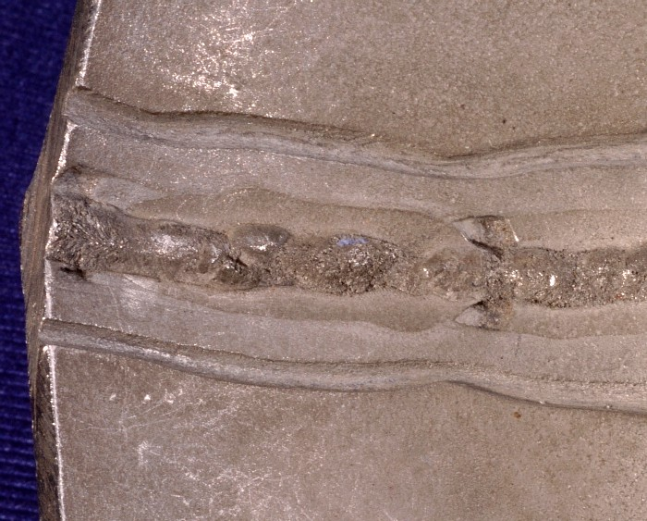
When does Intergranular Corrosion occur?
Properly processed stainless steels are not prone to IC
May occur in the Heat Affected Zone of a weld (either side of a weld bead) when
  The Carbon content is high
  and the steel is not stabilized (by Ti, Nb, Zr * which “trap” the carbon in the matrix, making it unavailable for grain boundary carbides)
* This is why there are grades containing Ti and/or Nb and/or Zr, grades qualified as “stabilized”
‘Tram-line’ attack
Weld Decay
To find out more about welding and other joining methods, please go to Module 09

Slide 35
How to avoid Intergranular Corrosion
Use low carbon grades, below 0,03% for austenitics
Or use stabilized grades for ferritics and austenitics
Or on austenitics, carry out a solution annealing treatment (at 1050°C all the carbides are dissolved) followed by quenching. (This is usually impractical, however).

Slide 36
f) What is Stress Corrosion Cracking¹ (SCC)?
Sudden cracking and failure of a component without deformation.
This may occur when
  The part is stressed (by an applied load or by a residual stress )
  The environment is aggressive (high chloride level, temperature above 50°C)
  The stainless steel his not sufficiently SCC resistant
Material Susceptible
Environment
Stress
Ferritic and duplex (i.e. austenitic-ferritic) stainless steels are immune to SCC

Slide 37
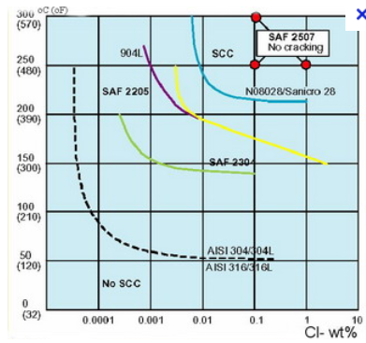
Mechanism of Stress corrosion cracking (SCC)
The combined action of environmental conditions (chlorides/elevated temperature) and stress - either applied, residual or both develop the following sequence of events:
  Pitting occurs
  Cracks start from a pit initiation site
  Cracks then propagate through the metal in a transgranular or intergranular mode.
  Failure occurs
Note: Please see Appendix for EN standards designations

Slide 38
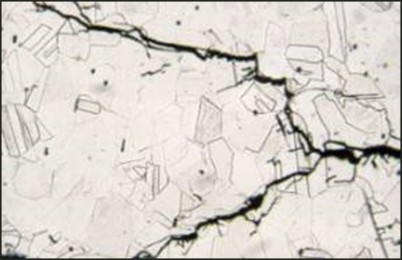
Avoiding SCC – two choices
Chloride induced stress corrosion cracking in standard austenitic stainless steels, viz. 1.4301/ 304 or 1.4401 /316
+Cr
Select duplex grades, more price stable (less nickel)
+Ni
+Mo
1.4462
1.4410
1.4501
1.4539
1.4547 (6Mo)
Select austenitic stainless steels with higher content of Ni and Mo (higher corrosion resistance)
Ferritic and duplex stainless steels are immune to stress corrosion cracking (because the ferrite phase, unlike the austenite phase is not sensitive to this type of corrosion).
For more information on these grades, please go to Module 04

Slide 39
4. How to select the right stainless steel for adequate corrosion resistance
Two different situations:
Structural applications ^{(10a)}
Other applications ^{(10b)}

Slide 40
4 - 1 Structural Applications
Eurocode 1-4 provides a procedure for selecting an appropriate grade of stainless steel for the service environment of structural members. (Please note that at the present time – i.e. nov 2014 – the recommendations of the Evolution Group for EN 1993-1-4 have not been yet enforced)
This procedure is presented in the next slides
It is applicable to:
Load bearing members
Outdoor use
Environments without frequent immersion in sea water
pH between 4 and 10
No exposure to chemical process flow stream

Slide 41
How the procedure works
The environment is assessed by a Corrosion Resistance Factor (CRF) made of 3 components (CRF= F1+F2+F3) where
  F1 rates the risk of exposure to chlorides from salt water or deicing salts
  F2 rates the risk of exposure to sulphur dioxide
  F3 rates the cleaning regime or exposure to washing by rain
A matching table indicates for a given CRF the corresponding CRC class
The stainless steel grades are placed in corrosion resistance classes (CRC) I to V according to the CRF value
The tables are shown in the next 4 slides

Slide 42
F₁ Risk of exposure to CI (salt water or deicing salts)
Note: M is distance from the sea and S is distance from roads with deicing salts
1 | Internally controlled environment
0 | Low risk of exposure | M > 10 km or S > 0.1 km
-3 | Medium risk of exposure | 1 km < M ≤ 10 km or 0.01 km < S ≤ 0.1 km
-7 | High risk of exposure | 0.25 km < M ≤ 1 km or S ≤ 0.01 km
-10 | Very high risk of exposure Road tunnels where deicing salt is used or where vehicles might carry deicing salts into the tunnel
-10 | Very high risk of exposure North Sea coast of Germany All Baltic coastal areas | M ≤ 0.25 km
-15 | Very high risk of exposure | M ≤ 0.25 km
 | Atlantic coast line of Portugal, Spain, France Coastline of UK, France, Belgium, Netherlands, Southern Sweden All other coastal areas of UK, Norway, Denmark and Ireland Mediterranean Coast

Slide 43
F₂ Risk of exposure to sulphur dioxide
Note: for European coastal environments the sulphur dioxide value is usually low. For inland environments the sulphur dioxide value is either low or medium. The high classification is unusual and associated with particularly heavy industrial locations or specific environments such as road tunnels. Sulphur dioxide deposition may be evaluated according to the method in ISO 9225.
0 | Low risk of exposure | (<10 µg/m³ average deposition)
-5 | Medium risk of exposure | (10 – 90 µg/m³ average deposition)
-10 | High risk of exposure | (90 – 250 µg/m³ average deposition)
F₃ Cleaning regime or exposure to washing by rain (if F₁ + F₂ = 0, then F₃ = 0)
0 | Fully exposed to washing by rain
-2 | Specified cleaning regime
-7 | No washing by rain or No specified cleaning

Slide 44
Matching Table
Table A.2: Determination of Corrosion Resistance Class CRC
Corrosion Resistance Factor (CRF) | Corrosion Resistance Class (CRC)
CRF = 1 | I
0 ≥ CRF > -7 | II
-7 ≥ CRF > -15 | III
-15 ≥ CRF ≥ -20 | IV
CRF < -20 | V

Slide 45
Corrosion resistance classes of stainless steels
Table A.3: Grades in each Corrosion Resistance Class CRC
 |  | Corrosion resistance class CRC
I |  | II |  | III |  | IV |  |  | V
1.4003 |  | 1.4301 |  | 1.4401 |  | 1.4439 |  |  | 1.4565
1.4016 |  | 1.4307 |  | 1.4404 |  | 1.4539 |  |  | 1.4529
1.4512 |  | 1.4311 |  | 1.4435 |  | 1.4462 |  |  | 1.4547
 |  | 1.4541 |  | 1.4571 |  |  |  |  | 1.4410
 |  | 1.4318 |  | 1.4429 |  |  |  |  | 1.4501
 |  | 1.4306 |  | 1.4432 |  |  |  |  | 1.4507
 |  | 1.4567 |  | 1.4578
 |  | 1.4482 |  | 1.4662
 |  |  |  | 1.4362
 |  |  |  | 1.4062
 |  |  |  | 1.4162
 | Ferritics |  |  |  | Std Austenitics |  |  | Mo Austenitcs
 | Lean duplex |  |  |  | Super Austenitics |  |  | Duplex/super duplex
Notes: | Please see the appendix for EN standards designations This does not apply to swimming pools
Updated 2019

Slide 46
4 -2 Other applications
No specific regulations are applicable
Grade selection must be adequate for the expected performance
Three ways to do this:
  Ask an expert
  Get help from stainless steel development associations
  Find out successful cases with similar environments (usually available)

Slide 47
Grade Selection Guide for Architecture¹⁰
Caution: NOT applicable when
Appearance does not matter
Structural integrity is the primary concern (Then go to 4 – 1)

Slide 48
How the procedure works
An evaluation score must be computed
For each score a list of recommended stainless steel grades is provided
Criteria used in the evaluation score (see the next slides):
Environmental Pollution
Coastal exposure or Deicing salts exosure
Local weather pattern
Design considerations
Maintenance schedule

Slide 49
Environmental pollution
Points
 | Rural
0 | Very low or no pollution
 | Urban pollution (Light industry, automotive exhaust)
0 | Low
2 | Moderate
3 | High *
 | Industrial pollution (Aggressive gases, iron oxides, chemicals, etc.)
3 | Low or moderate
4 | High *
* Potentially a highly corrosive location. Have a stainless steel expert evaluate the site.

Slide 50
A) Coastal exposure
Points
 | Coastal or Marine Salt Exposure
1 | Low (>1.6 to 16 km (1 to 10 miles) from salt water) **
3 | Moderate (30m to 1.6 km (100 ft to 1 mile) from salt water)
4 | High (<30m (100 ft) from salt water)
5 | Marine (some salt spray or occasional splashing) *
8 | Severe Marine (continuous splashing) *
10 | Severe Marine (continuous immersion) *
* Potentially a highly corrosive location. Have a stainless steel corrosion expert evaluate the site. ** This range shows how far chlorides are typically found from large salt water bodies. Some locations of this type are exposed to chlorides but others are not.

Slide 51
B) Deicing salts exposure
Points
 | Deicing Salt Exposure (Distance from road or ground)
0 | No salt was detected on a sample from the site and no change in exposure conditions is expected.
0 | Traffic and wind levels on nearby roads are too low to carry chlorides to the site and no deicing salt is used on sidewalks
1 | Very low salt exposure (≥10 m to 1 km (33 to 3,280 ft) or 3 to 60 floors) **
2 | Low salt exposure (< 10 to 500 m (33 to 1600 ft) or 2 to 34 floors) **
3 | Moderate salt exposure (< 3 to 100 m (10 to 328 ft) or 1 to 22 floors) **
4 | High salt exposure (<2 to 50 m (6.5 to 164 ft) or 1 to 3 floors) * **
* Potentially a highly corrosive location. Have a stainless steel corrosion expert evaluate the site. ** This range shows how far this chloride concentration has been found from small rural and large high traffic roads. Test surface chloride concentrations.
Note: if both coastal exposure and deicing salts are present, please ask an expert

Slide 52
Local weather pattern
Points
-1 | Temperature or cold climates, regular heavy rain
-1 | Hot or cold climates with typical humidity below 50%
0 | Temperature or cold climate, occasional heavy rain
0 | Tropical or subtropical, wet, regular or seasonal very heavy rain
1 | Temperature climate, infrequent rain, humidity above 50%
1 | Regular very light rain or frequent fog
2 | Hot, humidity above 50%, very low or no rainfall ***
*** If there is also salt or pollution exposure, have a stainless steel corrosion expert evaluate the site.

Slide 53
Design Considerations
Points
0 | Boldly exposed for easy rain cleaning
0 | Vertical surfaces with a vertical or no finish grain
-2 | Surface finish is pickled, electropolished, or roughness ≤ R_{a} 0.3 µm (12µin)
-1 | Surface finish roughness R_{a} 0.3 µm (12µin) < X ≤ R_{a} 0.5 µm (20µin)
1 | Surface finish roughness R_{a} 0.5 µm (20µin) < X ≤ R_{a} 1 µm (40µin)
2 | Surface finish roughness > R_{a} 1 µm (40µin)
1 | Sheltered location or unsealed crevices ***
1 | Horizontal surfaces
1 | Horizontal finish grain orientation
*** If there is also salt or pollution exposure, have a stainless steel corrosion expert evaluate the site.
About Ra: https://www.worldstainless.org/Files/issf/non-image-files/PDF/Euro_Inox/RoughnessMeasurement_EN.pdf
This table shows that corrosion resistance depends also on surface finish.
For more information on the available finishes, please go to Module 08

Slide 54
Maintenance schedule
Points
0 | Not washed
-1 | Washed at least naturally
-2 | Washed four or more times per year
-3 | Washed at least monthly

Slide 55
Stainless Steel selection scoring system
Total score | Stainless Steel Selection
0 to 2 | Type 304/304L is generally the most economical choice
3 | Type 316/316L or 444 is generally the most economical choice
4 | Type 317L or a more corrosion resistant stainless steel is suggested
≥ 5 | A more corrosion resistant stainless steel such as 4462, 317LMN, 904L, super duplex, super ferritic or a 6% molybdenum super austenitic stainless steel may be needed
Note: please see the appendix for EN standard designations
Proper selection of the stainless steel grades will lead to a long, maintenance-free, service life with a low life cycle cost and an excellent sustainability
For more information sustainability, please go to Module 11

Slide 56
Conclusion
Proper selection of the right stainless steel grade for the application and the environment deserves attention.
When this is done, stainless steel will provide unlimited service life without maintenance.
You will find in Module 2 a wide range of successful applications of stainless steels,
and in Module 1 timeless art, worldwide!

Slide 57
5. References
An excellent course on corrosion. Please look at chapters 7 (Galvanic Corrosion), 8 (intergranular corrosion), 11 (crevice corrosion) 12 (pitting) 14 (Stress corrosion cracking) and 15 (stress corrosion cracking of stainless steels) Original source: http://corrosion.kaist.ac.kr Dowloads available from: https://www.worldstainless.org/Files/issf/Education_references/Zrefs_on_corrosion.zip
Some basics on corrosion from NACE http://corrosion-doctors.org/Corrosion-History/Course.htm#Scope
An online course on corrosion http://www.corrosionclinic.com/corrosion_online_lectures/ME303L10.HTM#top
Information on electrochemical testing http://mee-inc.com/esca.html
Ugitech: private communication
BSSA (British Stainless Steel Association) website ” Calculation of pitting resistance equivalent numbers (PREN)” http://www.bssa.org.uk/topics.php?article=111
On Pitting corrosion https://kb.osu.edu/dspace/bitstream/handle/1811/45442/FrankelG_JournalElectrochemicalSociety_1998_v145n6_p2186-2198.pdf?sequence=1
http://www.imoa.info/download_files/stainless-steel/Duplex_Stainless_Steel_3rd_Edition.pdf
http://www.imoa.info/molybdenum-uses/molybdenum-grade-stainless-steels/steel-grades.php
http://www.imoa.info/download_files/stainless-steel/IMOA_Houska-Selecting_Stainless_Steel_for_Optimum_Perormance.pdf
http://en.wikipedia.org/wiki/Galvanic_corrosion
http://www.bssa.org.uk/topics.php?article=668
http://www.stainless-steel-world.net/pdf/SSW_0812_duplex.pdf
http://www.outokumpu.com/en/stainless-steel/grades/duplex/Pages/default.aspx
http://www.aperam.com/uploads/stainlesseurope/TechnicalPublications/Duplex_Maastricht_EN-22p-7064Ko.pdf
http://www.bssa.org.uk/topics.php?article=606
a) 通用不锈钢板材EN 10088-2的化学组成: http://www.bssa.org.uk/topics.php?article=44 b) 通用不锈钢长材EN 10088-3的化学成分: http://www.bssa.org.uk/topics.php?article=46

Slide 58
Appendix: Designations¹⁷
Note: This is a simplified table. For special grades, please look at reference 17.

Slide 59
Thank you
Test your knowledge of stainless steel here:
https://www.surveymonkey.com/r/3BVK2X6

