Slide 1
Supporting presentation for lecturers of Architecture/Civil Engineering
Part A:
Structural Applications of
Stainless Steel Reinforcing Bar
See also: stainlesssteelrebar.org

Slide 2
Wrong choice of materials can lead to big problems

Slide 3
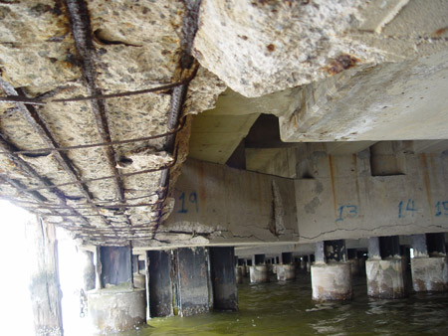
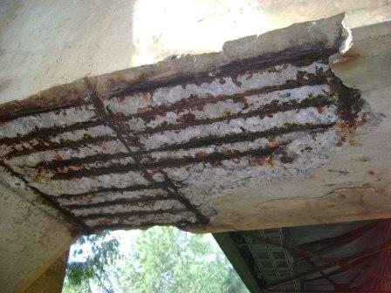
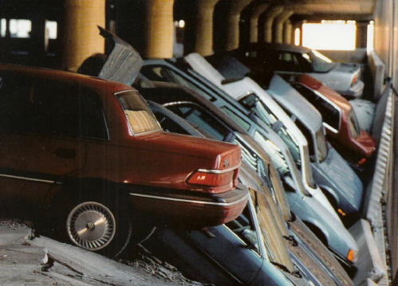
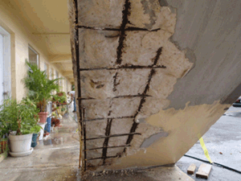

Slide 4
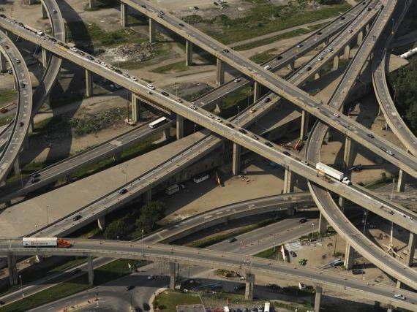
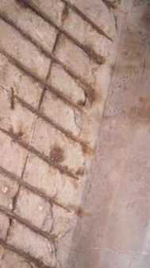
A textbook case: Corrosion of the Turcot highway interchange in Montreal ^{1,2}
A key interchange between Decarie (North-South) and Ville Marie (East-West) highways, built in 1966.
Over 300,000 vehicles per day
Made of reinforced concrete, badly corroded today by deicing salts

Slide 5
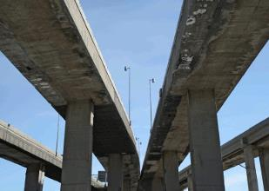
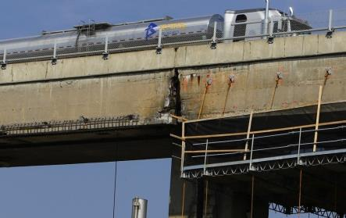
It had to be replaced
In spite of constant supervision and repairs, it had to be replaced,
  Cost CAD 3000M.
  Moreover, CAD 254M had to be spent to ensure safety until its replacement in 2018
Lifespan of the structure was only 50 years!

Slide 6
How reinforced concrete can be damaged by corrosion

Slide 7
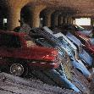


Diffusion of corrosive ions (usually chlorides) into concrete:
Steps³:
Once corrosive ions reach the carbon steel rebar (t0), corrosion begins
Corrosion products, which occupy a greater volume than steel, exert an outwards pressure
Concrete cracking occurs (t1), opening easy access to chlorides
Concrete cover cracks (spalling) (t3), exposing the rebar
If unattended, corrosion continues until the rebar cannot bear the applied tensile stresses and the structure collapses (t4)

Slide 8
Corrosion of rebar in concrete ²¹
In the high pH of concrete, in the absence of chlorides, carbon steel rebar is in a passive state (i.e. does not corrode)
A low chloride content is sufficient to activate corrosion of carbon steel
Stainless steel properly specified never corrodes.
Galvanic coupling between stainless steel rebar (anode) and carbon steel rebar (cathode) contributes only to ~1% of the overall corrosion rate*. It is therefore negligible.
Type of concrete, temperature, exposure conditions, distance between carbon steel rebar and surface, etc… have a strong influence on the corrosion rate of the carbon steel rebar
* Specific references are provided at the end of the presentation

Slide 9
Cracks in concrete accelerate corrosion ⁴
Concrete often exhibits cracks, though which corrosive ions reach quickly the steel.
Here are some causes of crack formation.
Please note that cracks do not take place immediately, and will also occur in concealed areas, where they cannot be repaired.
Type of cracking | Form of crack | Primary Cause | Time of Appearance
Plastic settlement | Above and aligned with steel reinforcement | Subsidence around rebar; excessive water in the mix | 10 minutes to three hours
Plastic shrinkage | Diagonal or random | Excessive early evaporation | 30 minutes to six hours
Thermal expansion and contraction | Transverse (example: across the pavement) | Excessive heat generation or temperature gradients | One day to two or three weeks
Drying shrinkage | Transverse or pattern | Excessive water in the mix; poor joint placement; joints over-spaced | Weeks to months
Freezing and thawing | Parallel to the concrete surface | Inadequate air entrainment; non-durable coarse aggregate | After one or more winters
Corrosion of reinforcement | Above reinforcement | Inadequate concrete cover; ingress of moisture or chloride | More than two years
Alkali-aggregate reaction | Pattern cracks; cracks parallel to joints or edges | Reactive aggregate plus moisture | Typically, over five years, but may be much sooner with highly reactive aggregate
Sulfate attack | Pattern cracks | External or internal sulfates promoting the formation of ettringite | One to five years

Slide 10
Major civil engineering structures must last over 100 years now

Slide 11
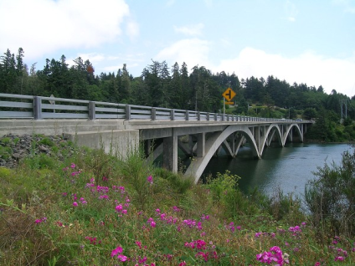
Haynes Inlet Slough Bridge, Oregon, USA 2004^{7,8}
An unusual arch-hinged bridge with 400 tons of stainless steel reinforcing bar in its deck.
The 230m-long link over Haynes Inlet Slough is expected to last 120 maintenance-free years.
Although stainless steel costs a lot more than average steel, the bridge life-cycle cost will be greatly reduced.

Slide 12
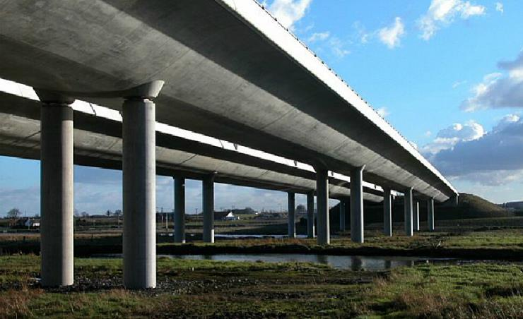
Broadmeadow Bridge, Dublin, Ireland (2003)¹⁰
A new construction built over the estuary using 105MT of stainless steel reinforcement in the columns and parapets.
Notes:
Courtesy Frank Smith

Slide 13
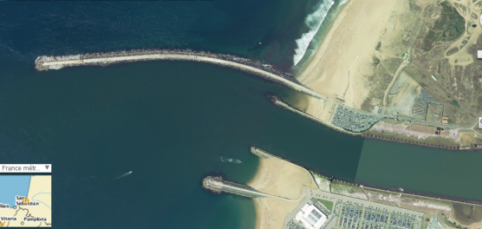
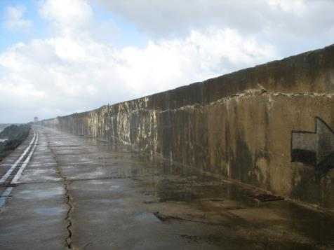
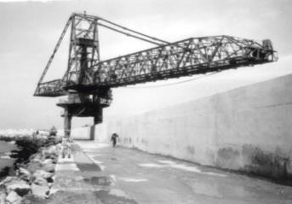
Dam repair ¹¹
Bayonne, France
  Dam built in the 1960s to protect the entrance to the harbour
  The ocean side is higher and protected by 40T blocks which must be replaced as the storms wear them
  On the river side a 7m wide platform allows the heavy-duty cranes to lift the blocks
Aerial view
Cracks on the deck and wall required repairs

Slide 14
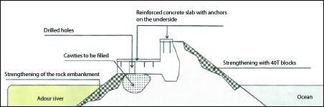
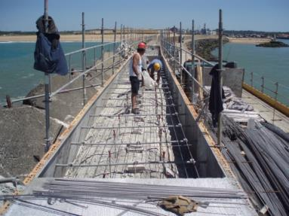
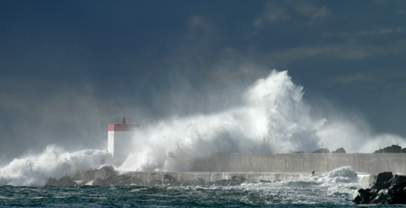
Sea wall repair
Bayonne, France
Section through the sea wall
Platform and sea wall have been reinforced with lean duplex stainless steel (EN 1.4362)¹¹
Sea wall repair under way
Early 2014 gale over the dam

Slide 15
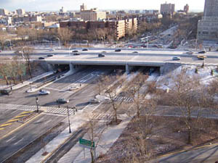
Belt Parkway Bridge, Brooklyn, USA (2004)¹⁴
To assure long-term (100 years) durability and resistance to the corrosive attack of the area’s marine environment and road salt, the bridge units and parapet barriers were reinforced with stainless steel grade 2205 rebar.

Slide 16
When should stainless steel rebar be considered ¹⁵⁻²⁰:
In corrosive environments:
Sea water and even more in hot climates
  Bridges
  Piers
  Docks
  Anchors for lampposts, railings,….
  Sea walls
  …..
Deicing salts
  Bridges
  Traffic overpasses and interchanges
  Parking garages
Waste water treatment tanks
Desalination plants
In structures with a very long life
  Repairs of historic structures
  Nuclear waste storage
In unknown environments in which
  inspection is impossible,
  Repairs are almost impossible or very expensive

Slide 17
Comparison of stainless rebar with alternative solutions¹⁵⁻²⁰
 | Advantages | Drawbacks
Epoxy coating | Lower initial costs | cannot be bent without cracking Requires careful handling to avoid damaging it during installation
Galvanizing | Lower initial costs | cannot be bent without cracking No longer effective when the zinc coating has been corroded
Fiber-reinforced Polymers | Lower initial costs | Cannot be bent without cracking No heat resistance and poor impact resistance in harsh winters Lower stiffness than that of steel Cannot be recycled
STAINLESS STEEL | Low Life Cycle cost: Design similar to C-steels Mixed C-steel/stainless reinforcements work well Easy installation, insensitive to poor worknanship No maintenance No life limit Allows a thinner concrete cover Better fire resistance 100% Recycled to premium stainless | Higher initial cost, but no more than a few % when Stainless is selected for the critical areas Lean duplex grades are selected

Slide 18
Comparison of stainless rebar with alternative solutions¹⁵⁻²⁰
 | Advantages | Drawbacks
Cathodic protection | Lower initial costs ? Often used for repairs | Requires careful design for overall protection Requires careful installation to maintain proper electrical contacts Requires a permanent source of current (which must be monirored and maintained) or sacrificial anodes that require monitoring & replacement
Membranes/ sealants | Lower initial costs? | Require careful installation (bubbles) Cannot be installed in any weather Performance over time debatable Limited to horizontal surfaces

Slide 19
References
http://www.lapresse.ca/actualites/montreal/201111/25/01-4471833-echangeur-turcot-254-millions-pour-lentretien-avant-la-demolition.php
http://www.ledevoir.com/politique/quebec/336978/echangeur-turcot-quebec-confirme-le-mauvais-etat-des-structures
https://www.worldstainless.org/Files/issf/Education_references/Ref07_The_use_of_predictive_models_in_specifying_selective_use_of_stainless_steel_reinforcement.pdf
https://www.holcim.com.au/products-and-services/tools-faqs-and-resources/do-it-yourself-diy/cracks-in-concrete visual inspection of concrete
https://www.nickelinstitute.org/policy/nickel-life-cycle-management/life-cycle-assessments/ (Progreso Pier)
https://www.worldstainless.org/Files/issf/Education_references/Ref08_Special-issue-stainless-steel-rebar-Acom.pdf
https://www.roadsbridges.com/willing-bend-0 (Oregon)
http://structurae.net/structures/data/index.cfm?id=s0011506 (Oregon)
http://www.aeconline.ae/major-hong-kong-stainless-steel-rebar-contract-signed-by-arminox-middle-east-42317/news.html (HK Macau)
http://www.engineersireland.ie/EngineersIreland/media/SiteMedia/groups/Divisions/civil/Broadmeadow-Estuary-Bridge-Integration-of-Design-and-Construction.pdf?ext=.pdf (Broadmeadow)
Courtesy Ugitech SA
http://www.arup.com/Projects/Stonecutters_Bridge.aspx (stonecutters’bridge)
https://www.worldstainless.org/Files/issf/non-image-files/PDF/Structural/Stonecutters_Bridge_Towers.pdf (stonecutters’bridge)
http://www.cif.org/noms/2008/24_-_Ocean_Parkway_Belt_Bridge.pdf (belt parkway bridge)
Béton Armé d’inox: Le Choix de la durée (in French) https://www.infociments.fr/ponts-et-passerelles/les-armatures-inox-la-solution-pour-des-ouvrages-durables
Armaduras de Acero Inoxidable (in Spanish) http://www.cedinox.es/opencms901/export/sites/cedinox/.galleries/publicaciones-tecnicas/59armadurasaceroinoxidable.pdf
www.ukcares.com/downloads/guides/PART7.pdf
https://www.worldstainless.org/Files/issf/Education_references/Ref19_Case_study_of_progreso_pier.pdf
http://www.sintef.no/upload/Byggforsk/Publikasjoner/Prrapp%20405.pdf (general)
http://americanarminox.com/Purdue_University_Report_-_Stainless_Steel_Life_Cycle_Costing.pdf (advantages of using ss rebar)
http://www.stainlesssteelrebar.org

Slide 20
References on Galvanic Coupling
NEW !
L. Bertolini, M. Gastaldi, T. Pastore, M. P. Pedeferri and P. Pedeferri, “Effects of Galvanic Coupling between Carbon Steel and Stainless Steel Reinforcement in Concrete”, International Conference on Corrosion and Rehabilitation of Reinforced Concrete Structures, 1998, Orlando, Florida.
A. Knudsen, EM. Jensen, O. Klinghoffer and T. Skovsgaard, “Cost-Effective Enhancement of Durability of Concrete Structures by Intelligent use of Stainless Steel Reinforcement”, International Conference on Corrosion and Rehabilitation of Reinforced Concrete Structures, 1998, Orlando, Florida.
L. Bertolini, M. Gastaldi, T. Pastore and M. P. Pedeferri, “Effect of Chemical Composition on Corrosion Behaviour of Stainless Steel in Chloride Contamination and Carbonated Concrete”, Properties and Performances, Proceedings of 3rd European Congress Stainless Steel '99, 1999, Vol .3, Chia Laguna, AIM
O. Klinghoffer, T. Frolund, B. Kofoed, A. Knudsen, EM. Jensen and T. Skovsgaard, “Practical and Economic Aspects of Application of Austenitic Stainless Steel, AISI 316, as Reinforcement in Concrete”, Corrosion of Reinforcement in Concrete: Corrosion Mechanisms and Corrosion Protection, 2000, Mietz, J., Polder, R. and Elsener, B., Eds, London
Knudsen and T. Skovsgaard, “Stainless Steel Reinforcement”, Concrete Engineering, 2001, Vol. 5 (3), p. 59.
L. Bertolini and P. Pedeferri, “Laboratory and Field Experience on the Use of Stainless Steel to Improve Durability of Reinforced Concrete”, Corrosion Review, 2002, Vol. 20, p. 129
S. Qian, D. Qu & G. Coates Galvanic Coupling Between Carbon Steel and Stainless Steel Reinforcements Canadian Metallurgical Quarterly Volume 45, 2006 - Issue 4 Pages 475-483 Published online: 18 Jul 2013
J.T. Pérez-Quiroz, J. Teran, M.J. Herrera, M. Martinez, J. Genesca : “Assessment of stainless steel reinforcement for concrete structures rehabilitation” J. of Constructional Steel research (2008) doi:10.1016/j.jcsr.2008.07.024
Juliana Lopes Cardoso / Adriana de Araujo / Mayara Stecanella Pacheco / Jose Luis Serra Ribeiro / Zehbour Panossian “stainless-steel-rebar-for-marine-environment-a-study-of-galvanic-corrosion-with-carbon-steel-rebar-used-in-the-same-concrete-structure” (2018) https://store.nace.org/stainless-steel-rebar-for-marine-environment-a-study-of-galvanic-corrosion-with-carbon-steel-rebar-used-in-the-same-concrete-structure Product Number: 51318-11312-SG
http://stainlesssteelrebar.org/

Slide 21
Thank you
Test your knowledge of stainless steel here:
https://www.surveymonkey.com/r/3BVK2X6

Slide 22
Supporting presentation for lecturers of Architecture/Civil Engineering
Part B
Structural Applications of
Stainless Steel Plates, Sheets, Bars, ….

Slide 23
Structural Stainless Steel
Designing with stainless steel
Barbara Rossi, Maarten Fortan
Civil Engineering department,
KU Leuven, Belgium
Based on a previous version prepared by Nancy Baddoo
Steel Construction Institute, Ascot, UK

Slide 24
Outline
Examples of structural applications
Material mechanical characteristics
Design according to Eurocode 3
Alternative methods
Deflections
Additional information
Resources for engineers
Notes:
This lecture is concerned with the use of stainless steel in structural and civil engineering applications. It gives specific guidance for design. This is the second of two lectures: the first lecture gives an overview of what stainless steel is and the issues you should consider when you specify it. Throughout the presentation, stainless steel is compared with structural carbon steel.

Slide 25
Section 1
Examples of structural applications
Notes:
OBJECTIVE: provide an overview of the possible applications

Slide 26
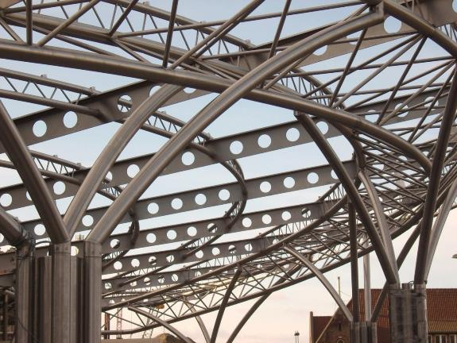
Station Sint Pieters, Ghent (BE)
Arch : Wefirna
Eng. Off.: THV Van Laere-Braekel Aero

Slide 27
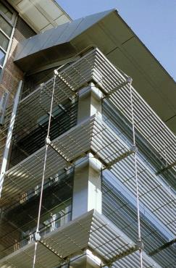
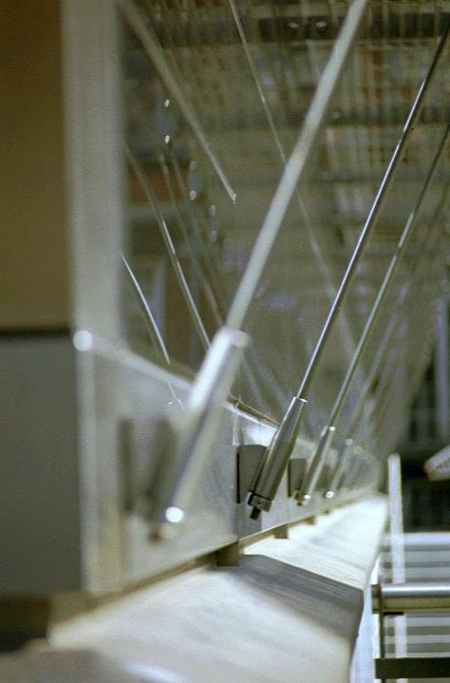
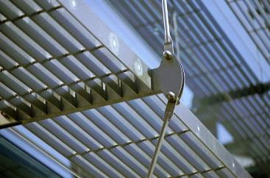
Military School in Brussels
Arch : AR.TE
Eng. Off.: Tractebel Development

Slide 28


La Grande Arche, Paris
Arch : Johan Otto von Spreckelsen
Eng. Off.: Paul Andreu
Notes:
Architekt Johan Otto von Spreckelsen (*)
ADP / P. Andreu / F. Deslaugiers
110 m hoch, 35 Geschosse
Nord-/Südflügen 19 m dick

Slide 29
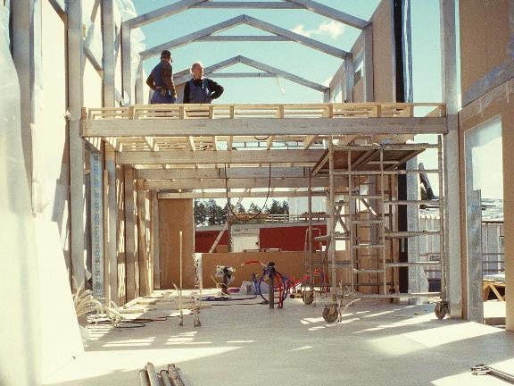
Villa Inox (FIN)

Slide 30
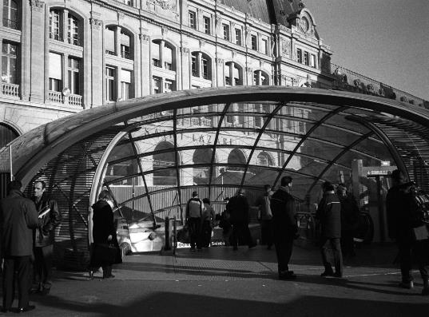
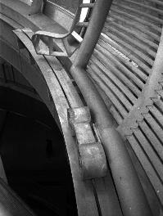
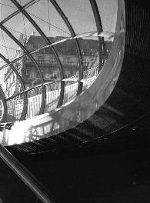
La Lentille de Saint-Lazare, Paris, (France)
Arch: Arte Charpentiers & Associés
Eng. Off.: Mitsu Edwards

Slide 31
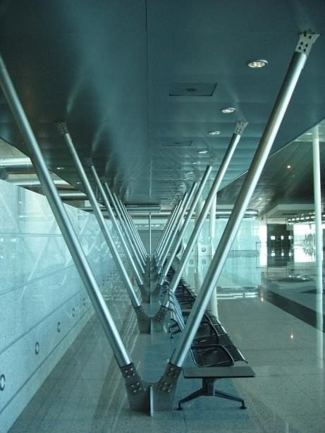
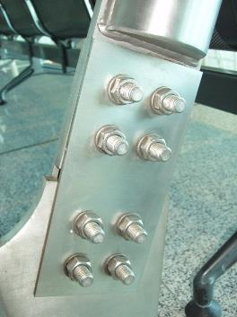
Station in Porto (Portugal)

Slide 32

Torno Internazionale S.P.A. Headquarters Milan, (IT), Stainless steel grade: EN 1.4404 (AISI 316L)
Architect : Dante O. BENINI & Partners Architects
Photography: Toni Nicolino / Nicola Giacomin

Slide 33
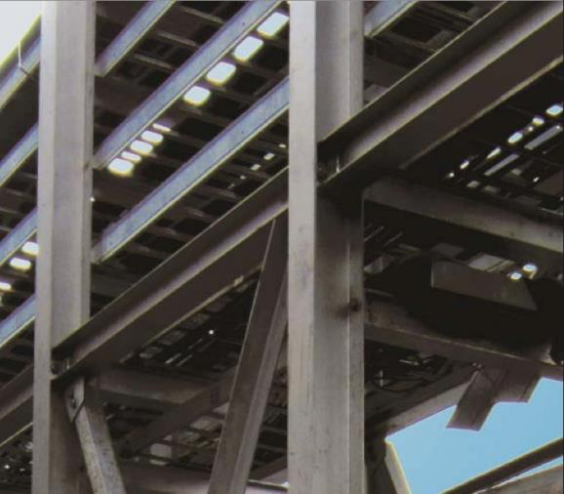
Stainless steel frames in nuclear power plant
Photography: Stainless Structurals LLC

Slide 34
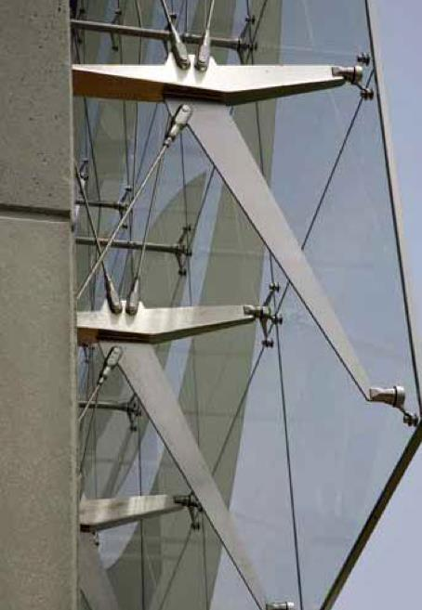
Stainless steel façade supports, Tampa, (USA)
Photography: TriPyramid Structures, Inc.

Slide 35
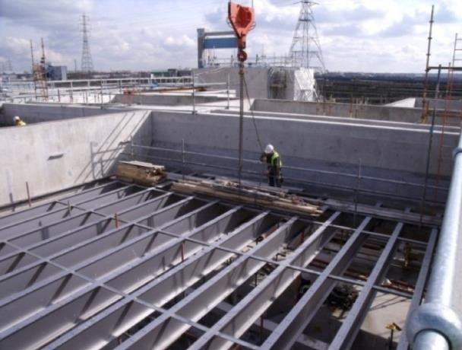
Stainless steel I-shaped beams,
Thames Gateway Water Treatment Works, (UK)
Photography: Interserve

Slide 36
Section 2
Material mechanical characteristics
Notes:
OBJECTIVE: discuss the material characteritics and the differences with CS

Slide 37
Stress-Strain characteristics:
Carbon steel vs stainless steel
Stainless steel exhibits fundamentally different σ-ε behaviour to carbon steel.
Carbon steel has a sharply defined yield point with a plastic yield plateau.
Strain hardening
Stress σ
Inelastic response
Stainless steel exhibits gradually yielding behaviour, with high strain-hardening.
Strain ε

Slide 38
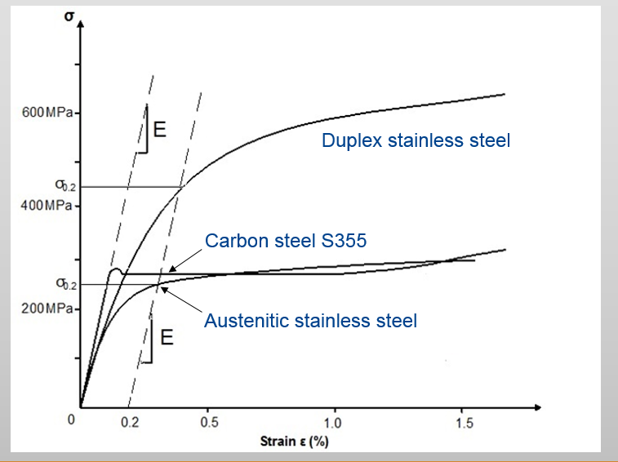
Stress-strain characteristics – low strain
Stress-strain response depends on the family.
Notes:
The key difference between carbon steel and stainless steel is in the stress-strain curve, as shown on this slide. Carbon steel has linear elastic behavior up-until a sharply defined yield point, after which strain can increase with no increase in stress, although there may be an small amount of strain hardening.
Stainless steel does not exhibit such behavior. Instead, yielding is more gradual, with a considerable level of strain hardening.

Slide 39
Design strength of stainless steel
Minimum specified 0.2% proof strength are given in EN 10088-4 and -5
Austenitics: f_{y} = 220-350 MPa
Duplexes: f_{y} = 400-480 Mpa
Ferritics: f_{y} = 210-280 MPa
Young’s modulus: E=200,000 to 220,000 MPa
σ_{y}
Stress σ
0,2 %
Strain ε
Notes:
With carbon steel, the yield strength is simply taken as the design strength. The difficulty in designing with materials which have a non-linear stress-strain curve is the choice of design strength.
The conventional way of defining the design strength for metals like stainless steel, aluminium alloys and high strength steels which do not exhibit a clear yield point, is to use the 0.2% proof strength.
This graph shows the definition of the ‘0.2% proof strength’.
Austenitic stainless steels have a 0.2% proof strength of around 220 MPa whereas duplexes are about twice as strong, with a 0.2% proof strength of around 450 MPa.
The high strength of duplex stainless steel will often permit a lighter section to be used compared with carbon steel.
It should be noted that the measured yield strength of austenitic stainless steels may exceed the specified minimum values by a margin varying from 25 to 40%, for plate thicknesses of 25 mm or less. The margin for duplex stainless steels is lower, perhaps up to 20%. There is an inverse relationship between thickness or diameter, and yield stress; thinner material typically have yield stresses that are significantly higher than the minimum requirement whereas at thicknesses of 25 mm and above, the values are usually fairly close to the specified values.
The Young's Modulus is 200,000 MPa, which is only slightly different to the value assumed for carbon steel, around 210,000 MPa.

Slide 40
Design strength of stainless steel
Grade | Family | Yield strength (N/mm²) 0.2% proof strength | Ultimate strength (N/mm²) | Young’s Modulus (N/mm²) | Fracture strain (%)
1.4301 (304) | Austenitic | 210 | 520 | 200000 | 45
1.4401 (316) | Austenitic | 220 | 520 | 200000 | 40
1.4062 | Duplex | 450 | 650 | 200000
1.4462 | Duplex | 460 | 640 | 200000
1.4003 | Ferritic | 250 | 450 | 220000

Slide 41
Strain hardening
(work hardening or cold working)
Increased strength by plastic deformation
Caused by cold-forming, either during steel production operations at the mill or during fabrication processes
During the fabrication of a rectangular hollow section, the 0.2% proof strength increases by about 50% in the cold-formed corners of cross sections!
Notes:
Stainless steels exhibit strong strain hardening, which can be advantageous in some situations and disadvantageous in others.

Slide 42
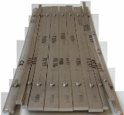
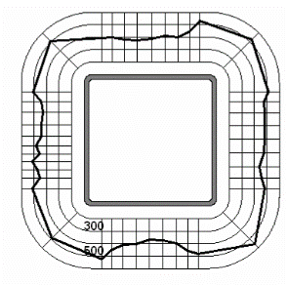
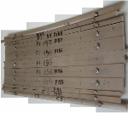
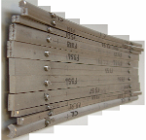
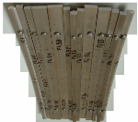
Strain hardening
(work hardening or cold working)
Strength enhancement during forming
σ_{0.2,meas}
σ_{0.2,mill}
σ_{0.2,min}
weld
Notes:
Material properties vary around cold-formed stainless steel sections due to the effects of cold-work. This is also seen for carbon steel – it’s much more significant for stainless steel….
By slicing specimens into a series of strips and then measuring the stress-strain characteristics, its possible to build up a profile of strength around the section, and with sufficient data, predictive tools can be developed – this process is underway at the moment.

Slide 43
Strain hardening – not always useful
Heavier and more powerful fabrication equipment
Greater forces are required
Reduced ductility (however, the initial ductility is high, especially for austenitics)
Undesirable residual stresses may be produced
Notes:
The reduction in ductility is never a problem with austenitics because they have such high ductility to start with, around 50% (more on this later in the presetnation).

Slide 44
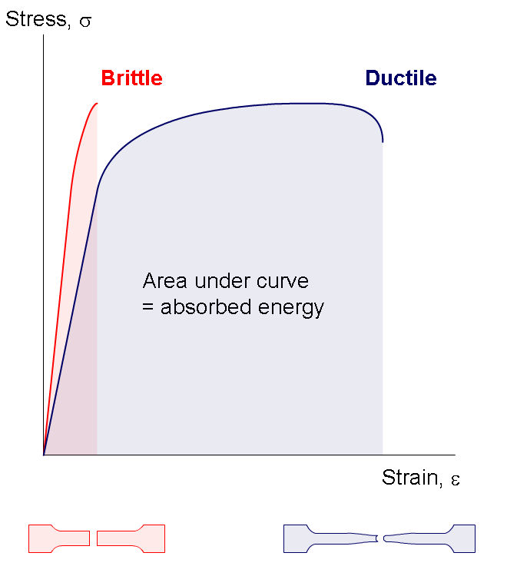
Ductility and toughness
Ductility - ability to be stretched without breaking
Toughness - ability to absorb energy & plastically deform without fracturing
Notes:
Stainless steel also differs from carbon steel in terms of ductility and toughness.

Slide 45
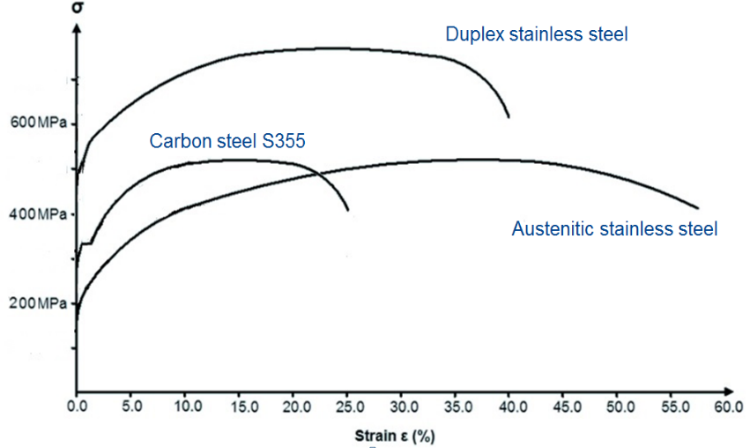
Stress-Strain Characteristics – high strain
Duplex stainless steel
600MPa
Carbon steel S355
400MPa
Austenitic stainless steel
200MPa
Strain ε (%)
Notes:
This graph shows the full stress-strain curves to fracture and enables us to compare the ductility and toughness of stainless steel and carbon steel. It can be seen that austenitic stainless steel is considerably more ductile than carbon steel. And austenitic stainless steel also shows greater toughness (compare the area under the stress-strain curves).

Slide 46
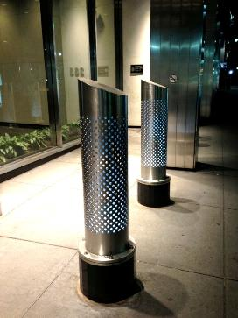
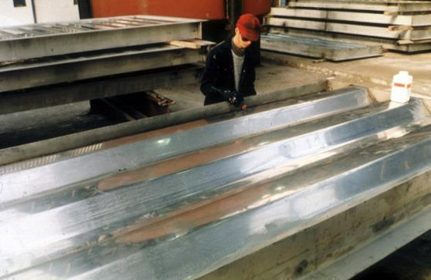
Blast/impact resistant structures
Security bollard
A trapezoidal blast resistant wall being fabricated for the topsides of an offshore platform
Notes:
Good impact resistance is also required for security bollards as well as blast resistant walls which are required to protect personnel on the topsides of offshore platforms in the event of an explosion.

Slide 47
Stress-strain characteristics
Nonlinearity………..leads to
  different limiting width to thickness ratios for local buckling
  different member buckling behaviour in compression and bending
  greater deflections
Notes:
We will now consider the impact of the non-linearity of the stress-strain curve on the structural performance of stainless steel.

Slide 48
Impact on buckling performance
Low slenderness
columns attain/exceed the squash load
⇒ benefits of strain hardening apparent
ss behaves at least as well as cs
High slenderness
axial strength low, stresses low and in linear region
⇒ ss behaves similarly to cs, providing geometric and residual stresses similar
Notes:
To consider the impact of the stress-strain characteristics on buckling performance, we will consider columns with low, high and intermediate slenderness separately.

Slide 49
Impact on buckling performance
Intermediate slenderness
average stress in column lies between the limit of proportionality and the 0.2% permanent strain,
ss column less strong than cs column

Slide 50
Material at elevated temperature
Stainless steel k_{2,θ}
Stainless steel k_{0.2p,θ}
Carbon steel k_{2,θ}
Carbon steel k_{0.2p,θ}
Strength reduction factors
Temperature (ºC)
k_{0.2p,q} = strength reduction factor at 0.2% proof strain
k_{2,q} = strength reduction factor at 2% total strain
Notes:
This graph shows a comparison of strength reduction factors at elevated temperatures between carbon steel and stainless steel, based on the strength at 2% strain, which is shown by the solid lines and the strength at 0.2% plastic strain, which is the dotted lines. And we can see that beyond about 550oC, stainless steel retains its strength better than carbon steel.

Slide 51
Material at elevated temperature
Temperature (ºC)
Stiffness reduction factor

Slide 52
Material at elevated temperature
Stainless steel
Carbon steel
Thermal expansion

Slide 53
Section 4
Design according to Eurocode 3

Slide 54
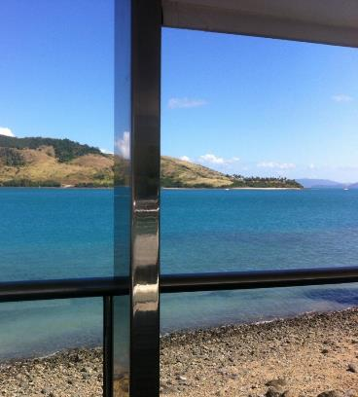
International design standards
What design standards are available for structural stainless steel?
Hamilton Island Yacht Club, Australia
Notes:
We will turn to consider design rules for structural stainless steel.
Although design standards vary around the world, their focus is always on safe, serviceable & economical structures.

Slide 55
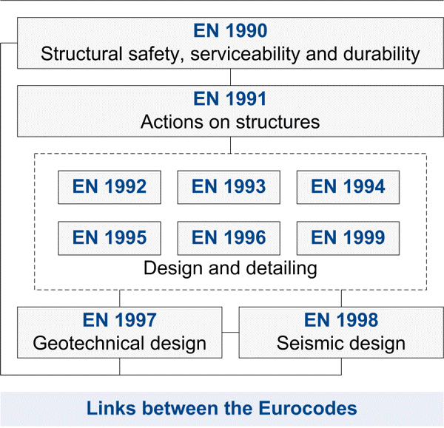
Eurocodes are an Integrated suite of structural design codes covering all common construction materials
Notes:
There are ten Eurocodes in all. Six of them deal with structural design using different materials:
Concrete,
Steel,
Composite (concrete and steel),
Masonry,
Aluminium,
Timber.
Eurocode 3 covers structural design with steel.

Slide 56
Eurocode 3: Part 1 (EN 1993-1)
EN 1993-1-1 General rules and rules for buildings.
EN 1993-1-2 Structural fire design.
EN 1993-1-3 Cold-formed members and sheeting .
EN 1993-1-4 Stainless steels.
EN 1993-1-5 Plated structural elements.
EN 1993-1-6 Strength and stability of shell structures.
EN 1993-1-7 Strength & stability of planar plated structures
transversely loaded.
EN 1993-1-8 Design of joints.
EN 1993-1-9 Fatigue strength of steel structures.
EN 1993-1-10 Selection of steel for fracture toughness and through- thickness properties.
EN 1993-1-11 Design of structures with tension components
EN 1993-1-12 Supplementary rules for high strength steels
Notes:
Eurocode 3 is divided into many parts. It covers design of different types of steel structures such as buildings, bridges, tanks, piling etc.
Part 1-4 gives structural rules for stainless steels.

Slide 57
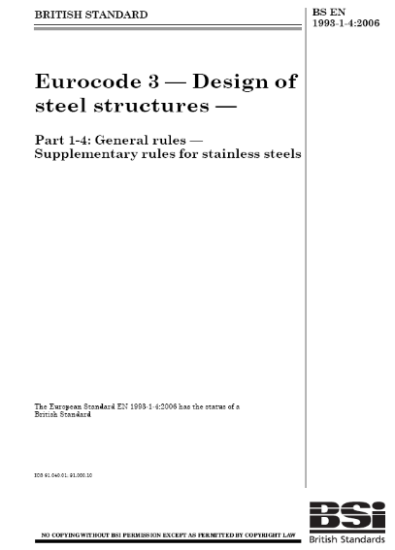
Eurocode 3: Design of Steel Structures,
Part 1.4 Supplementary rules for stainless steels
Design of steel structures.
Supplementary rules for stainless steels (2006)
Modifies and supplements rules for carbon steel given in other parts of Eurocode 3 where necessary
Applies to buildings, bridges, tanks etc
Notes:
The main part of the Eurocode that deals with Stainless steel is EN 1993-1-4. This part of Eurocode 3 provides supplementary rules for stainless steel where the behavior is different. The rules are generally presented in a similar way to those presented for carbon steel, in order to aid engineers who may have more experience with carbon steel.

Slide 58
Eurocode 3: Design of Steel Structures,
Part 1.4 Supplementary rules for stainless steels
Follow same basic approach as carbon steel
Use same rules as for carbon steel for tension members & restrained beams
Some differences in section classification limits, local buckling and member buckling curves apply due to:
  non-linear stress strain curve
  strain hardening characteristics
  different levels of residual stresses
Notes:
This slide summarises the difference between designing in stainless steel and carbon steel.

Slide 59
Eurocode 3: Design of Steel Structures,
Part 1.4 Supplementary rules for stainless steels
Types of members
Number of grades
Hot rolled and welded
Cold-formed
Bar
Family | EC3-1-4 | Future revision
Ferritic | 3 | 3
Austenitic | 16 | 16
Duplex | 2 | 6
Scope
Members and connections
Fire (by reference to EN 1993-1-2)
Fatigue (by reference to EN 1993-1-9)
Notes:
It is the only design standard in the world for stainless steel which covers such a comprehensive range of product forms and topics.

Slide 60
Other design standards
Japan – two standards: one for cold formed and one for welded stainless members
South Africa, Australia, New Zealand - standards for cold formed stainless members
Chinese - standard under development
US - ASCE specification for cold-formed members and AISC Design Guide for hot rolled and welded structural stainless steel
Notes:
There are other design standards for structural stainless steel, generally for cold formed material.

Slide 61
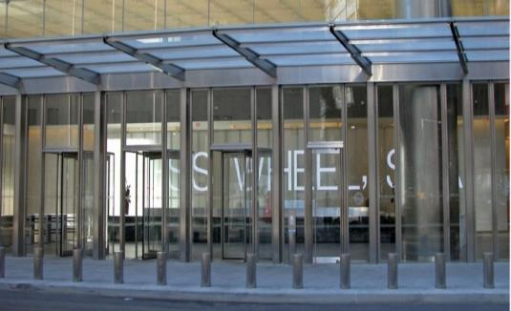
Eurocode 3: Design of Steel Structures,
Part 1.4 Supplementary rules for stainless steels
What are the design rules for stainless steel given in EN 1993-1-4 and the main differences with carbon steel equivalents?
Blast resistant columns in entrance canopy,
Seven World Trade Centre, New York
Notes:
The following slides will show the stainless steel design rules in EN 1993-1-4.

Slide 62
Section classification & local buckling expressions in EN 1993-1-4
Lower limiting width-to-thickness ratios than for carbon steel
Slightly different expressions for calculating effective widths of slender elements
However…
The next version of EN 1993-1-4 will contain less conservative limits & effective width expressions.
Notes:
Carbon steel and stainless steel are classified into four classes in exactly the same way. However the limiting width-to-thickness ratios for stainless steel are generally lower than for carbon steel.
Carbon steel cross section classifications for different standard sections are published in various resources, e.g. SCI Blue Book. A similar resource is not available for stainless steel, as there is no standard family of cross section shapes. The designer will therefore be required to classify the section themselves, which can be laborious. Software is available to simplify the task, as can be found at www.steel-stainless.org/software
Since the design rules in the Eurocode were derived, a great deal more test data have become available for structural stainless steel and these data now justify the use of less conservative section classification limits, generally aligned to the carbon steel limits. The limits will therefore be raised in the next version of EN 1993-1-4, due to be published in 2014.

Slide 63
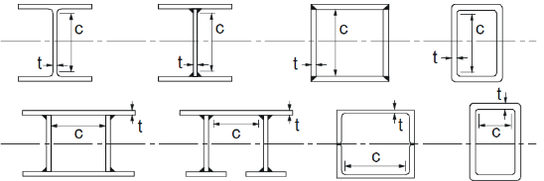

Section classification & local buckling expressions in EN 1993-1-4
Internal compression parts
$$ε=\sqrt{\frac{235}{f_{y}} \frac{E}{210000}}$$
 | EC3-1-1: carbon steel |  | EC3-1-4: stainless steel |  | EC3-1-4: Future revision
Class | Bending | Compression | Bending | Compression | Bending | Compression
1 | c/t ≤ 72ε | c/t ≤ 33ε | c/t ≤ 56ε | c/t ≤ 25,7ε | c/t ≤ 72ε | c/t ≤ 33ε
2 | c/t ≤ 83ε | c/t ≤ 38ε | c/t ≤ 58,2ε | c/t ≤ 26,7ε | c/t ≤ 76ε | c/t ≤ 35ε
3 | c/t ≤ 124ε | c/t ≤ 42ε | c/t ≤ 74,8ε | c/t ≤ 30,7ε | c/t ≤ 90ε | c/t ≤ 37ε

Slide 64
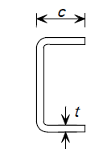
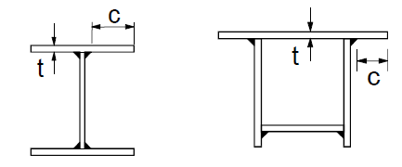
Section classification & local buckling expressions in EN 1993-1-4
External compression parts
$$ε=\sqrt{\frac{235}{f_{y}} \frac{E}{210000}}$$
 | EC3-1-1: carbon steel | EC3-1-4: stainless steel |  | EC3-1-4: future revision
Class | Compression | Compression Welded | Compression Cold-formed | Compression
1 | c/t ≤ 9ε | c/t ≤ 9ε | c/t ≤ 10ε | c/t ≤ 9ε
2 | c/t ≤ 10ε | c/t ≤ 9,4ε | c/t ≤ 10,4ε | c/t ≤ 10ε
3 | c/t ≤ 14ε | c/t ≤ 11ε | c/t ≤ 11,9ε | c/t ≤ 14ε

Slide 65
Design of columns & beams
In general use same approach as for carbon steel
But use different buckling curves for buckling of columns and unrestrained beams (LTB)
Ensure you use the correct f_{y} for the grade (minimum specified values are given in EN 10088-4 and -5)
Notes:
The minimum specified values of 0.2% proof strength are given in the harmonised material standards:
EN 10088-4 is the harmonised product standard for stainless steel sheet, strip and plate.
EN 10088-5 is the harmonised product standard for stainless steel bar and rod.

Slide 66
“Perfect” column behaviour
Two bounds: Yielding and buckling:
Load
Material yielding (squashing)
N_{Ed}
Af_{y}
L_{cr}
Euler (critical) buckling N_{cr}
N_{Ed}
Yielding
Buckling
Slenderness

Slide 67
Column buckling
Compression buckling resistance N_{b,Rd}:
for Class 1, 2 and 3
Reduction factor
for (symmetric) Class 4

Slide 68
Column buckling
Non-dimensional slenderness:
= for Class 1, 2 and 3 cross-sections
= for Class 4 cross-sections
N_{cr} is the elastic critical buckling load for the relevant buckling mode based on the gross properties of the cross-section

Slide 69
Column buckling
Reduction factor:
Imperfection factor
Plateau length

Slide 70
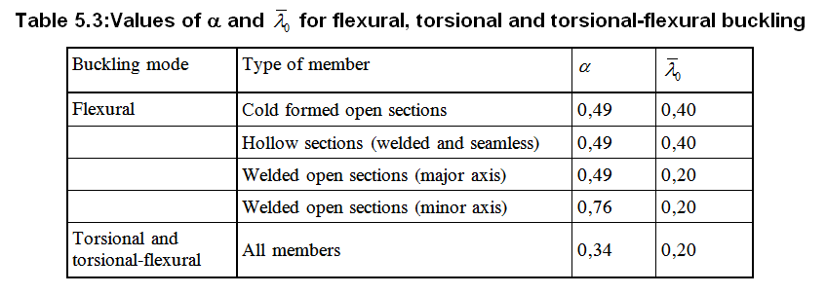
Column buckling
Choice of buckling curve depends on cross-section, manufacturing route and axis
Extract from EN 1993-1-4
Notes:
The buckling curves for stainless steel take the same mathematical form as those for carbon steel but the imperfection factor (alpha) and limiting slenderness (lambda bar zero) are different.

Slide 71

Eurocode 3 Flexural buckling curves
Notes:
This graph compares the flexural buckling curves for carbon steel (welded I sections and hollow sections) and stainless steel (welded I sections and hollow sections)

Slide 72


Eurocode 3 Flexural buckling example
Cold formed rectangular hollow section submitted to concentric compression
 | Carbon steel | Austenitic stainless steel
Material | S235 | EN 1.4301
f_{y} [N/mm²] | 235 | 230
E [N/mm²] | 210000 | 200000

Slide 73




Eurocode 3 flexural buckling example
EC 3-1-1: S235
EC 3-1-4: Austenitic
Classification
  All internal parts
  $c/t=21<33=33ε$
  Class 1
Cross-section = class 1
Classification
  All internal parts
  $c/t=21<25,35=25,7ε$
  Class 1
Cross-section = class 1
$$ε=\sqrt{\frac{235}{f_{y}} }=1$$
$ε=\sqrt{\frac{235}{f_{y}} \frac{E}{210000}}=$0,99

Slide 74

Eurocode 3 flexural buckling example
 | EC 3-1-1: S355 | EC 3-1-4: Duplex
A [mm²] | 1495 | 1495
f_{y} [N/mm²] | 235 | 230
 | 1 | 1,1
N_{c,Rd} [kN] | 351 | 313
L_{cr} [mm] | 2100 | 2100
 | 93,9 | 92,6
 | 0,575 | 0,583
 | 0,49 | 0,49
 | 0,2 | 0,4
 | 0,76 | 0,71
 | 0,80 | 0,89
 | 1 | 1,1
N_{b,Rd} [kN] | 281 | 277

Slide 75

Eurocode 3 flexural buckling example
Comparison
  In this example, cs and ss show similar resistance to flexural buckling
  ⇒ benefits of strain hardening not apparent
  EC3 1-4 doesn’t take duly account for strain hardening
 | EC 3-1-1: S235 | EC 3-1-4: Austenitic
f_{y} [N/mm²] | 235 | 230
 | 1,0 | 1,1
 | 1,0 | 1,1
Cross-section N_{c,Rd} [kN] | 351 | 313
Stability N_{b,Rd} [kN] | 281 | 277

Slide 76
Lateral torsional buckling
Can be discounted when:
  Minor axis bending
  CHS, SHS, circular or square bar
  Fully laterally restrained beams
  < 0.4
LTB
Notes:
Lateral torsional buckling is the member failure mode associated with unrestrained beams loaded about their major axis….

Slide 77
Lateral torsional buckling
The design approach for lateral torsional buckling is analogous to the column buckling treatment.
M
Material yielding (in-plane bending)
W_{y}f_{y}
M_{Ed}
M_{Ed}
Elastic member buckling M_{cr}
L_{cr}
Yielding
Buckling
Non-dimensional slenderness

Slide 78
Lateral torsional buckling
The design buckling resistance M_{b,Rd} of a laterally unrestrained beam (or segment of beam) should be taken as:
Reduction factor for LTB

Slide 79
Lateral torsional buckling
Lateral torsional buckling curves are given below:
Plateau length
Imperfection factor

Slide 80

Eurocode 3 Lateral torsional buckling curves
Notes:
This graph compares the lateral torsional buckling curves for carbon steel (welded I sections and cold formed channels) and stainless steel (welded I sections and cold formed channels)

Slide 81
Non-dimensional slenderness
Lateral torsional buckling slenderness:
  Buckling curves as for compression (except curve a₀)
  W_{y} depends on section classification
  M_{cr} is the elastic critical LTB moment

Slide 82


Eurocode 3 Lateral torsional buckling example
I-shaped beam submitted
to bending
 | Carbon steel | Duplex stainless steel
Material | S355 | EN 1.4162
f_{y} [N/mm²] | 355 | 450
E [N/mm²] | 210000 | 200000

Slide 83




Eurocode 3 Lateral torsional buckling example
EC 3-1-1: S355
EC 3-1-4: Duplex
Classification
  Flange
  $c/t=6,78<7,3=9ε$
  Class 1
  Web
  $c/t=45,3<58,3=72ε$
  Class 1
Cross-section = class 1
Classification
  Flange
  $c/t=6,78<7,76=11ε$
  Class 3
  Web
  $c/t=45,3<58,3=72ε$
  Class 3
Cross-section = class 3
$$ε=\sqrt{\frac{235}{f_{y}} }=0,81$$
$$ε=\sqrt{\frac{235}{f_{y}} \frac{E}{210000}}=0,71$$

Slide 84



Eurocode 3 Lateral torsional buckling example
EC 3-1-1: S355
EC 3-1-4: Duplex
Ultimate moment
  Class 1
  $$M_{c,Rd}=\frac{W_{pl∙}f_{y}}{γ_{M0}}=196 kNm$$
Ultimate moment
  Class 3
  $$M_{c,Rd}=\frac{W_{el∙}f_{y}}{γ_{M0}}=202 kNm$$
Revision EC 3-1-4:
Classification limits: closer to carbon steel
  Cross-section = class 2
  $M_{c,Rd}=\frac{W_{pl∙}f_{y}}{γ_{M0}}=226 kNm$

Slide 85

Eurocode 3 Lateral torsional buckling example
Elastic critical buckling moment:
Critical elastic buckling load
  $$M_{cr}=C_{1} \frac{π^{2}EI_{z}}{{(k}_{z}L)^{2}} \left\{\sqrt{\left[{\left(\frac{k_{z}}{k_{ω}}\right)}^{2} \frac{I_{ω}}{I_{z}}+\frac{{\left(k_{z}L\right)}^{2}GI_{T}}{π^{2}EI_{z}}+{\left(C_{2}z_{g}\right)}^{2}\right]}− C_{2}z_{g}\right\}$$
 | EC 3-1-1: S355 | EC 3-1-4: duplex
C₁ [-] | 1,04 | 1,04
C₂ [-] | 0,42 | 0,42
k_{z} [-] | 1 | 1
k_{w} [-] | 1 | 1
z_{g} [mm] | 160 | 160
I_{z} [mm⁴] | 5,6.10⁶ | 5,6.10⁶
I_{T} [mm⁴] | 1,2.10⁵ | 1,2.10⁵
I_{w} [mm⁶] | 1,2.10¹¹ | 1,2.10¹¹
E [MPa] | 210000 | 200000
G [MPa] | 81000 | 77000
M_{cr} [kNm] | 215 | 205

Slide 86

Eurocode 3 Lateral torsional buckling example
Lateral torsional buckling resistance
 | EC 3-1-1: S355 | EC 3-1-4: Duplex | EC 3-1-4: Future revision
W_{y} [mm³] | 5,5.10⁵ | 4,9.10⁵ | 5,5.10⁵
f_{y} [N/mm²] | 355 | 450 | 450
M_{cr} [kNm] | 215 | 205 | 205
 | 0,96 | 1,04 | 1,10
 | 0,49 | 0,76 | 0,76
 | 0,2 | 0,4 | 0,4
 | 1,14 | 1,29 | 1,37
 | 0,57 | 0,49 | 0,46
 | 1,0 | 1,1 | 1,1
M_{b,Rd} [kNm] | 111 | 99 | 103

Slide 87

Eurocode 3 Lateral torsional buckling example
Comparison
  In this example, cs and ss show similar resistance to LTB
  However: Current tests and literature show that the EC3-1-4 results should be adapted to be closer to reality
  ⇒ too conservative
  (This will be shown in the example on finite element methods)
 | EC 3-1-1: S355 | EC 3-1-4: Duplex | EC 3-1-4: Future revision
f_{y} [N/mm²] | 355 | 450 | 450
 | 1,0 | 1,1 | 1,1
 | 1,0 | 1,1 | 1,1
Cross-section M_{c,Rd} | 196 | 202 | 226
Stability M_{b,Rd} | 111 | 99 | 103

Slide 88
Section 4
Alternative methods

Slide 89
Alternative methods
Direct strength method (DSM)
  Part of the American code
  For thin-walled profiles
Continuous strength method (CSM)
  Includes the beneficial effects of strain hardening
Finite element methods
  More tedious
  Can include all the specificities of the model

Slide 90





Direct strength method
AISI Appendix 1
Very simple and straightforward method
Used for thin-walled sections
But requires an “Elastic buckling analysis”
  Theoretical method provided in the literature
  Finite strip method (for example CUFSM)
More info : http://www.ce.jhu.edu/bschafer/
Prequalified member?
  Members with a lot of experimental data
  Safety factors more conservative for
  non-prequalified members

Slide 91

Direct strength method – example
Lipped C-channel submitted to compression
  Simply supported column
  Column length: 5m
 | Ferritic stainless steel
Material | EN 1.4003
f_{y} [N/mm²] | 280
f_{u}[N/mm²] | 450
E [N/mm²] | 220000

Slide 92




Direct strength method example
First step: Elastic buckling analysis
Local
Distortional
Global

Slide 93
Direct strength method – example
Output of the analysis = “Elastic critical buckling load”
  In the example, the load factor from elastic buckling analysis equals:
    For local buckling: 0,80
    For distortional buckling: 1,26
    For global buckling: 0,28
Second step: Calculation of the nominal strengths for
    Local buckling ⇨ one equation
    Distortional buckling ⇨ one equation
    Global buckling ⇨ one equation

Slide 94

Direct strength method example

Slide 95

Direct strength method example

Slide 96

Direct strength method example

Slide 97
Direct strength method – example
Third step : The axial resistance is “just” the minimum of the three nominal strengths
    Local: P_{nl} = 93,81 kN
    Distortional: P_{nd} = 344,56 kN
    Global: P_{ne} = 93,81 kN
  ⇒ P_{n} = 93,81 kN

Slide 98
Continuous strength method
Stainless steel material characteristics:
  Non-linear material model
  High train hardening
  Conventional design methods not able to take into account the full potential of the cross-section
The Continuous strength method uses a material model which includes strain hardening

Slide 99

Continuous strength method
Material model considered in the CSM:
Stress
Ramberg-Osgood model
CSM model
f_{u}
f_{y}
Strain
0,002
ε_{y}
0,1ε_{u}
15ε_{y}
0,16ε_{u}

Slide 100


Continuous strength method
Comparison between EC3 and CSM predictions versus tests:
In compression
In bending
N_{u,test} (kN)
M_{u,test} (kNm)
CSM
EN 1993-1-4
CSM
EN 1993-1-4
N_{u,pred} (kN)
M_{u,pred} (kNm)
The CSM is able to accurately capture the cross-section behaviour

Slide 101

CSM: Flexural buckling example
Cold formed rectangular hollow section submitted to concentric compression (example of slide 51)
 | Austenitic stainless steel
Material | EN 1.4301
f_{y} [N/mm²] | 230
E [N/mm²] | 200000

Slide 102

CSM: flexural buckling example
$$f_{y}=230N/{mm²}$$ | $$f_{u}=540N/{mm²}$$
$$E=200000 N/{mm²}$$ | ${0,16ε}_{u}=0,16(1−{f_{y}}/{f_{u}})=0,09$19
$$ε_{y}={f_{y}}/E=0,0012$$ | $$E_{sh}=\frac{f_{u}−f_{y}}{0,16ε_{u}−ε_{y}}=3418 N/{mm²}$$
f_{u}
E_{sh}
Stress σ
f_{y}
E
ε_{y}
Strain ε
0,16ε_{u}

Slide 103
CSM: flexural buckling example
$$f_{y}=230N/{mm²}$$ | $$f_{u}=540N/{mm²}$$
$$E=200000 N/{mm²}$$ | ${0,16ε}_{u}=0,16(1−{f_{y}}/{f_{u}})=0,09$19
$$ε_{y}={f_{y}}/E=0,0012$$ | $$E_{sh}=\frac{f_{u}−f_{y}}{0,16ε_{u}−ε_{y}}=3418 N/{mm²}$$
Stress σ
f_{csm}
ε_{csm}
Strain ε

Slide 104

CSM: flexural buckling example

Slide 105

CSM: flexural buckling example
 | EC 3-1-1: S235 | CSM: Austenitic | EC 3-1-4: Austenitic
f_{y} [N/mm²] | 235 | 230 | 230
 | 1,0 | 1,1 | 1,1
 | 1,0 | 1,1 | 1,1
Cross-section N_{c,Rd} [kN] | 351 | 335 | 313
Stability N_{b,Rd}[kN] | 281 | 294 | 277

Slide 106
Finite element model
The material stress-strain curve can be accurately modeled (for example by using Ramberg-osgood material law or “real” measured tensile coupon tests results)
Two-stage Ramberg-Osgood model:
Stress σ (N/mm²)
Strain ε

Slide 107
Finite element model
The nonlinear parameters are given by the following expressions (according to Rasmussen’s revision):

Slide 108

Finite element model
I-shaped beam submitted to bending suffering lateral torsional buckling : all imperfections can be modelled
: Lateral torsional buckling

Slide 109

Finite element model
The load-deflections curve can be calculated
  Results: elastic behaviour and first yielding
Total load (kN)
Vertical displacement (mm)

Slide 110

Finite element model
The load-deflections curve can be calculated
  Results: instability phenomenon => Lateral torsional buckling
Total load (kN)
Vertical displacement (mm)

Slide 111

Finite element model
The load-deflections curve can be calculated
  Results: instability phenomenon => Lateral torsional buckling
Total load (kN)
Vertical displacement (mm)

Slide 112

Finite element model
The load-deflections curve can be calculated
  Results: post buckling behaviour
Total load (kN)
Vertical displacement (mm)

Slide 113

Finite element model
The load-deflections curve can be calculated
  Results: post buckling behaviour
Total load (kN)
Vertical displacement (mm)

Slide 114


Finite element model
$M_{FEM}$=231 kNm
Eurocode 3-1-4 material model
Moment (kNm)
Eurocode 3-1-4
$M_{b,Rd}$=99 kNm
Vertical displacement (mm)

Slide 115



Finite element model
Measured mat. parameters
$M_{FEM}$=270 kNm
$M_{FEM}$=231 kNm
Eurocode 3-1-4 mat. model
Moment (kNm)
Eurocode 3-1-4
$M_{b,Rd}$=99 kNm
Vertical displacement (mm)

Slide 116
Section 5
Deflections

Slide 117
Deflections
Non-linear stress-strain curve means that stiffness of stainless steel ↓ as stress ↑
Deflections are slightly greater in stainless steel than in carbon steel
Use secant modulus at the stress in the member at the serviceability limit state (SLS)
Notes:
The non-linear stress-strain curve implies that the stiffness of stainless steel components varies with the stress level, the stiffness decreasing as the stress increases. Consequently, deflections are greater than those for carbon steels.
A conservative method for estimating deflections is to use standard structural theory, but with the secant modulus corresponding to the highest level of stress in the member instead of Young’s Modulus.

Slide 118

Deflections
Secant modulus E_{S} for the stress in the member at the SLS
Notes:
This slide illustrates the difference between the secant modulus and the tangent modulus. Clearly, at the origin of the stress-strain curve, the tangent modulus is equal to Young’s modulus.

Slide 119
Deflections
Secant modulus ES determined from the Ramberg-Osgood model:
f is stress at serviceability limit state
n is a material constant
Notes:
The secant modulus can be calculated using the Ramberg-Osgood model. This material model is the conventional model for describing the non-linear relationship of materials between stress and strain near their yield point.
The factor n describes how non-linear the material is. The more non-linear the stress-strain curve, the lower the value of n. Austenitics are characterised by an n value of about 5.6 and duplexes by an n value of 7.2. (A carbon steel bi-linear ‘elastic-perfectly plastic’ stress-strain curve would have an n value of infinity.)

Slide 120
Deflections in an austenitic stainless steel beam
Stress ratio f /f_{y} | Secant modulus, E_{S} N/mm² | % increase in deflection
0.25 | 200,000 | 0
0.5 | 192,000 | 4
0.7 | 158,000 | 27
f = stress at serviceability limit state
Notes:
This table shows how the deflection increases as the stress ratio (i.e. stress level) increases. At low stress ratios, the secant modulus equals Young’s modulus, 200 000 Mpa. As the stress ratio increases beyond 0.5, the secant modulus starts to reduce and has dropped down to 158 000 MPa at a stress ratio of 0.7.
The reduction in modulus for duplex stainless steels is very slight.

Slide 121
Section 6
Additional information

Slide 122
Response to seismic loading
Higher ductility (austenitic ss) + sustains more load cycles
→ greater hysteretic energy dissipation under cyclic loading
Higher work hardening
→ enhances development of large & deformable plastic zones
Stronger strain rate dependency –
→ higher strength at fast strain rates
Notes:
Since it is not economical to design structures to respond to earthquake loads in their elastic range, dissipation of energy by post-elastic deformation has become common practice. The energy that a structural system can dissipate in an earthquake event is a function of its inelastic deformations. This requires an understanding of the hysteretic behaviour of structural members.

Slide 123
Design of bolted connections
The strength and corrosion resistance of the bolts and parent material should be similar
Stainless steel bolts should be used to connect stainless steel members to avoid bimetallic corrosion
Stainless steel bolts can also be used to connect galvanized steel and aluminium members

Slide 124
Design of bolted connections
Rules for carbon steel bolts in clearance holes can generally be applied to stainless steel (tension, shear)
Special rules for bearing resistance required to limit deformation due to high ductility of stainless steel
f_{u,red} = 0.5f_{y} + 0.6f_{u} < f_{u}
Notes:
Bolted connections are designed in much the same way for either carbon steel or stainless steel. Special rules for bearing are required due to the high ductility of austenitic stainless steel.
Greater clarity is needed in defining bearing capacity with stainless steels: whereas the load deformation curve for carbon steel connections flattens off after the initiation and spreading of yielding, for stainless steel connections this curve continues to rise significantly owing to strain hardening.
The Eurocode defines the bearing capacity in terms of a reduced ultimate strength, f_{u,red ,} as opposed to the full ultimate strength used for carbon steel.

Slide 125
Preloaded bolts
Useful in structures like bridges, towers, masts etc when:
the connection is subject to vibrating loads,
slip between joining parts must be avoided,
the applied load frequently changes from a positive to a negative value
No design rules for stainless steel preloaded bolts
Tests should always be carried out
Notes:
Stainless steel bolts may be used as pretensioned bolts provided appropriate tensioning techniques are used. If stainless steel bolts are highly torqued, galling can be a problem. When pretension is applied, consideration should be given to time-dependent stress relaxation. Connections should not be designed as slip resistant at either the serviceability or ultimate limit state unless acceptability in the particular application can be demonstrated by testing. Slip coefficients for stainless steel faying surfaces are likely to be lower than those for carbon steel faying surfaces.

Slide 126
Design of welded connections
Carbon steel design rules can generally be applied to stainless steel
Use the correct consumable for the grade of stainless steel
Stainless steel can be welded to carbon steel, but special preparation is needed
Notes:
Stainless steel may be welded in much the same way as carbon steel.
It is essential that welds are made using correct procedures, including compatible filler metals, with suitably qualified welders. This is important not only to ensure the strength of the weld and to achieve a defined weld profile but also to maintain the corrosion resistance of the weld and surrounding material. It should be noted that greater welding distortions are associated with the austenitic stainless steels than with carbon steels
A common question is whether stainless steel can be welded to carbon steel. This is possible, providing the correct welding consumable is chosen.

Slide 127
Fatigue strength
Fatigue behaviour of welded joints is dominated by weld geometry
Performance of austenitic and duplex stainless steel is at least as good as carbon steel
Follow guidelines for carbon steel

Slide 128
Section 7
Resources for engineers

Slide 129
Resources for engineers
Online Information Centre
Case studies
Design guides
Design examples
Software
Notes:
There are a number of resources which give further guidance about designing stainless steel.

Slide 130

www.steel-stainless.org
Notes:
This is the SCI’s portal leading to various stainless steel resources related to construction applications.

Slide 131

Stainless in Construction Information Centre www.stainlessconstruction.com
Notes:
The Stainless in Construction Information Centre is a ‘one stop shop’ for information on designing with stainless steel.
The website includes links to stainless steel resources in a variety of languages. Links to many of the resources discussed in this presentation can be found by clicking the ‘Codes and Standards’ tab. The website includes a variety of other guidance, including case studies.

Slide 132





12 Structural Case Studies www.steel-stainless.org/CaseStudies
Notes:
12 case studies are available which illustrate a range of applications of structural stainless steel in bridges, buildings, offshore etc. The case studies describe the reason for using stainless steel, design basis, specification, and fabrication and installation issues.

Slide 133

Design Guidance to Eurocodes
www.steel-stainless.org/designmanual
Guidance
Commentary
Design examples
Online design software:
www.steel-stainless.org/software
Notes:
‘The Design Manual for Structural Stainless Steel’, now in its third edition, is a handbook to the design of structural stainless steel in accordance with EN 1993-1-4. The guide includes both general guidance and an extensive set of worked examples. A commentary has also been written that describes the research on which the guidance is based.

Slide 134
Summary
Structural performance:
similar to carbon steel but some modifications needed due to non-linear stress-strain curve
Design rules have been developed
Resources (design guides, case studies, worked examples, software) are freely available!
Notes:
To summarise, stainless steel can provide a cost effective and aesthetically pleasing solution if its unique properties are considered properly. Design of stainless steel is not very different to the design of carbon steel, although some limits and buckling curves will have changed. There are large number of resources that can help you specify and design in stainless steel.

Slide 135
References
EN 1993-1-1. Eurocode 3: Design of steel structures – Part1-1: General rules and rules for buildings. 2005
EN 1993-1-4. Eurocode 3: Design of steel structures – Part1-4: Supplementary rules for stainless steel. 2006
EN 1993-1-4. Eurocode 3: Design of steel structures – Part1-4: Supplementary rules for stainless steel. Modifications 2015
M. Fortan. Lateral-torsional buckling of duplex stainless steel beams - Experiments and design model. PhD thesis. 2014-…
AISI Standard. North American specification Appendix 1: Design of Cold-Formed Steel Structural Members Using the Direct Strength Method. 2007
B.W. Schafer. Review: The Direct Strength Method of cold-formed steel member design. Journal of Constructional Steel Research 64 (2008) 766-778
S.Afshan, L. Gardner. The continuous strength method for structural stainless steel design. Thin-Walled Structures 68 (2013) 42-49

Slide 136
Thank You
Barbara Rossi – barbara.rossi@kuleuven.be
Maarten Fortan – maarten.fortan@kuleuven.be
Test your knowledge of stainless steel here:
https://www.surveymonkey.com/r/3BVK2X6
Notes:
Thank you for listening.

